Slide 1
Biological monitoring
Notes:
Biological monitoring is the collection of biological data, specifically macroinvertebrate data. In this chapter, we will cover how to collect this data and how it helps us interpret stream health.

Slide 2
BIOLOGICAL MONITORING
Intro
Sensitive ID
Somewhat Tolerant ID
Tolerant ID
Methods
Data
Notes:
The topics covered in this chapter are an introduction to biological monitoring, identification of benthic macroinvertebrates, how to collect the macroinvertebrates, and how to record and interpret the data.

Slide 3
BIOLOGICAL sampling intro
Benthic Macroinvertebrates
Advantages
Pollution Tolerances
Notes:
To start things off, we’ll define benthic macroinvertebrates, the advantages of using biological sampling as an indicator of water quality, and the different categories of pollution tolerances that characterize different species of macroinvertebrates.

Slide 4
Benthic macroinvertebrates
Benthic
Stream Bottom
Macro
Large
Invertebrate
Organism without backbone
Intro
Sensitive ID
Somewhat Tolerant ID
Tolerant ID
Methods
Data
Notes:
It’s easiest to break down the term Benthic Macroinvertebrates into smaller parts to understand what it means. “
Benthic refers to the bottom of the stream. Macro means large, or visible with the naked eye. Invertebrates are organisms without a backbone. So, benthic macroinvertebrates are organisms that lack a backbone, are visible without magnification, and live on the stream bottom.
An example is a crayfish or crawdad.

Slide 5
Vital in stream ecosystems
Intro
Sensitive ID
Somewhat Tolerant ID
Tolerant ID
Methods
Data
Notes:
These invertebrates play a vital role in the stream ecosystem.
They are very important to the food chain, providing energy for numerous fish and other species. They also influence the nutrient cycle, primary productivity, decomposition of organic matter, and moving small materials within a stream system.

Slide 6
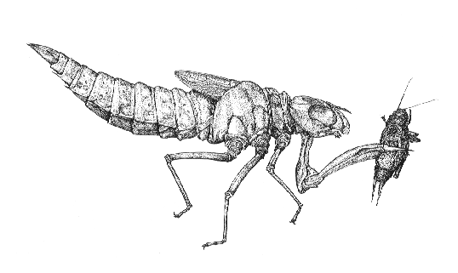
advantages
Less mobile
Easy to collect
Different pollution tolerances
Continuous monitoring
Inexpensive equipment
Easy to identify
No chemicals needed
Intro
Sensitive ID
Somewhat Tolerant ID
Tolerant ID
Methods
Data
Notes:
Invertebrates are indicators of stream health. There are several reasons why it is advantageous to use these spineless critters in assessing water quality.
Invertebrates are relatively non-mobile whereas fish will move if conditions start to deteriorate.
They are also easy to collect. We just need a net and something to agitate the rocks, like our two feet.
Some invertebrate species are sensitive to pollution, while others are more tolerant. This allows us to determine the condition of a stream based on the presence or absence of certain taxa.
Sampling macroinvertebrates allows for continuous monitoring. They are permanent residents of the stream. This makes them susceptible to pollutants present in the water. Chemical sampling only tells you what is happening in the stream at the exact moment you collect the sample. Some pollutants pulse through a stream due to variations in flow or to discharges from point sources that are released at intermittent times.
The equipment needed to collect macroinvertebrates is inexpensive compared to chemical monitoring equipment.
While debatable, macroinvertebrates are easy to ID. It may be difficult at first, but with practice, common invertebrates from your stream become familiar and easy to identify.
Finally, chemicals are not needed for macroinvertebrates sampling. This eliminates handling of chemicals, the need for reagent disposal and replacement of expired chemicals.

Slide 7
Taxonomic classification
Kingdom
Phylum
Class
Order
Family
Genus
Species
Class
Gilled snail, mussel, aquatic worm, leech, other snail
Order
Caddisfly, mayfly, stonefly, crayfish, scud, sowbug, other beetle larva
Sub-Order
Dragonfly, damselfly
Family
Riffle beetle, water penny, crane fly, alderfly, watersnipe fly, midge, pouch snail
Genus
Hellgrammite, fishfly
Intro
Sensitive ID
Somewhat Tolerant ID
Tolerant ID
Methods
Data
Notes:
Most invertebrates collected for biological monitoring are insect larvae or nymphs.
The taxonomic level they are identified down to depends on the ability of distinguishing the organisms with the bare eye, and maybe the help of a small magnifier.
Taxonomic classification is a hierarchal classification of organisms with Kingdom being the broadest and species being the most specific – and most difficult to distinguish.
You won’t need to know the taxonomic levels for water quality monitoring. This just shows how close some of the organisms are related and that some may have very similar characteristics. We also define the tolerance levels to the taxonomic levels to which we ID. For example, we will generally state that caddisflies are sensitive to pollution. But, some species of caddisflies are more tolerant to pollution.

Slide 8
Pollution tolerance
Pollution Sensitive
Somewhat Pollution Tolerant
Pollution Tolerant
Intro
Sensitive ID
Somewhat Tolerant ID
Tolerant ID
Methods
Data
Notes:
Let’s talk a little more on pollution tolerance, since this helps us understand how the invertebrates present indicate the health of the stream.
We consider three levels of pollution tolerance: pollution sensitive, somewhat pollution tolerant, and pollution tolerant.
Invertebrates that are pollution sensitive will only be present in streams with excellent water quality. Pollution tolerant invertebrates can be found in streams with severe impairment.
Note that pollution tolerant organisms can be found in all streams, including those of excellent water quality. We hope to find a diverse community with invertebrates from all three categories.
This image shows a fishfly larvae, which is somewhat tolerant to pollution.

Slide 9
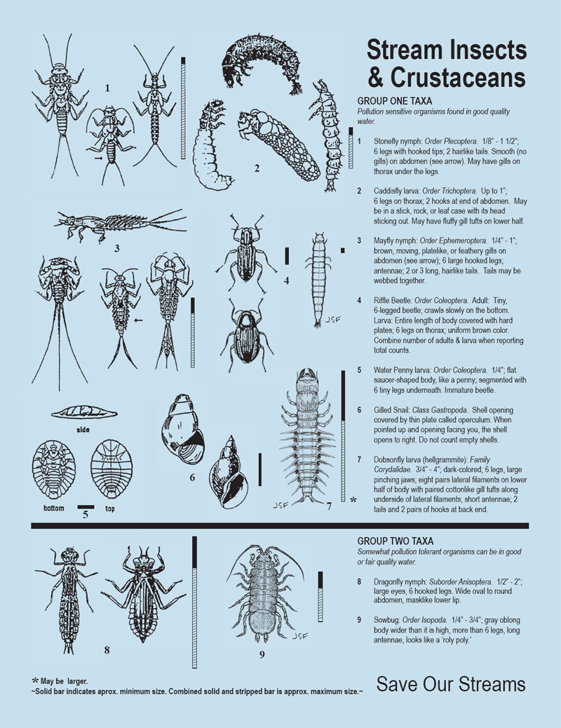
Blue Bug Card (front)
Notes:
The Missouri Stream Team program often references the Stream Insects & Crustaceans identification resource. This is also referred to as the Blue Bug Card because it’s printed on light blue paper.
The Blue Bug Card was adapted from the invertebrate identification tool produced by Izaak Walton League in Maryland. It is used commonly by water quality monitors from many states.
This resource shows invertebrate taxa by pollution sensitivity. Listed under group one is pollution sensitive. Group two shows somewhat-pollution tolerant. Group three is pollution tolerant and can be found on the backside.
There are size bars located next to each taxa of invertebrates. The full bar shows the maximum size and the black portion of the bar shows the average size.

Slide 10
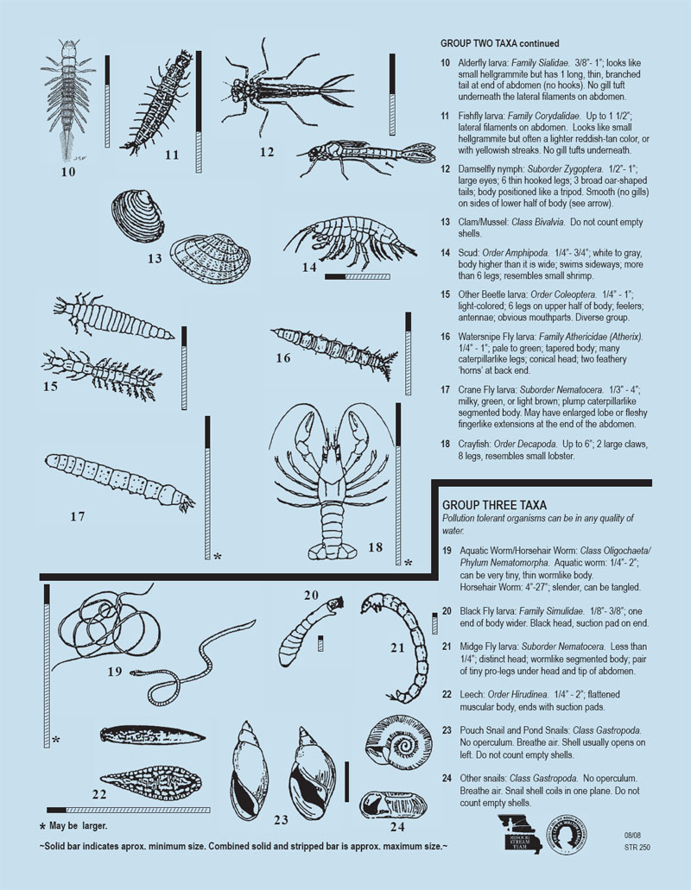
Blue Bug Card (back)
Notes:
Here is the backside of the Blue Bug Card, showing the remaining group two taxa and group three taxa..
You may notice that the sensitive organisms in group one have legs and gills. While the pollution tolerant organisms in group three lack legs and gills.
The Blue Bug Card can be found on the Missouri Stream Team website under Water Quality Monitoring Training Material and Resources or a free copy print can be requested through Stream Team staff.

Slide 11
INVERTEBRATE ID POLLUTION SENSITIVE
Notes:
Part of biological monitoring is identifying the invertebrates collected. We will give tips on identifying each taxa. This information can be found in the Introductory Level notebook under Water Quality Monitoring Resources on the website.
Let’s jump into identification of Pollution Sensitive invertebrates.

Slide 12
POLLUTION SENSITIVE taxa
Intro
Sensitive ID
Somewhat Tolerant ID
Tolerant ID
Methods
Data
Notes:
The Pollution Sensitive macroinvertebrates are located on the front of the Blue Bug card. We will work through each taxa, in no particular order, explaining key characteristics and tips for identification.

Slide 13
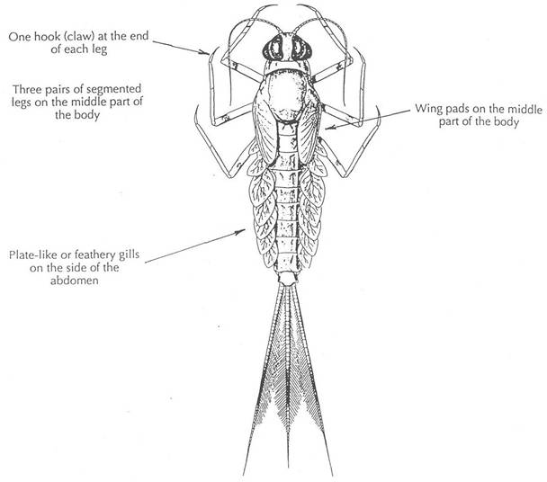
Anatomy of a mayfly
Head
Thorax
Legs
Wingpads
Abdomen
Gills
Tails
Intro
Sensitive ID
Somewhat Tolerant ID
Tolerant ID
Methods
Data
Notes:
For many of the invertebrates collected, they will have a head, thorax, and abdomen. It’s important to be able to identify these three body parts.
This drawing is a mayfly. You will see it has three pairs of legs.
Most mayflies also have three tails. Some mayflies only have two tails. And some mayflies may lose tails while being collected. So the number of tails can be an identifying clue, but don’t rely on it solely.
In this drawing you can see a row of plate-like gills along the abdomen. This is a key characteristic for identifying mayflies.
Remember, mayflies usually have 3 tails and gills along the abdomen.

Slide 14
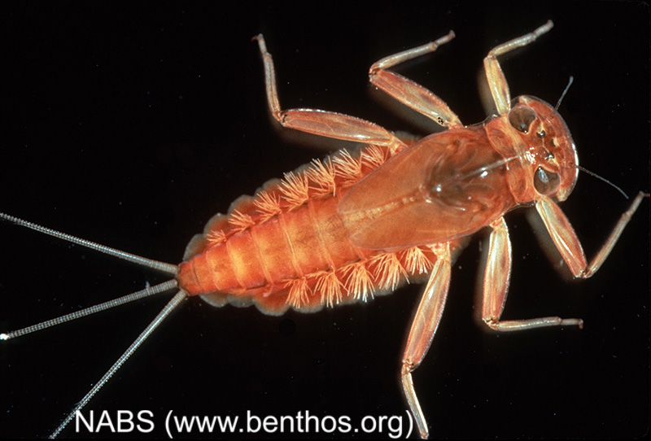
Mayfly nymph
Gills on the abdomen
3 tails
6 segmented legs
Intro
Sensitive ID
Somewhat Tolerant ID
Tolerant ID
Methods
Data
Notes:
Here is a photo of a mayfly nymph.
There are gills along the abdomen. When placed in a sorting tray with water, you can often see the gills undulating as the mayfly is moving water across the gills to breathe.
This species also has three hair-like tails.

Slide 15
Mayfly nymph
Gills on the
Abdomen
Intro
Sensitive ID
Somewhat Tolerant ID
Tolerant ID
Methods
Data
Notes:
This is also a mayfly as shown by the gills on the abdomen.
It looks different from the last mayfly image because they are two different species of mayflies.
Again, look for the gills on the abdomen and three tails to identify a mayfly.

Slide 16
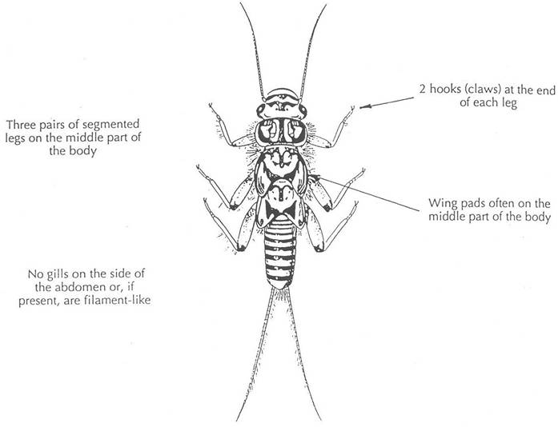
ANATOMY OF A sTONEFLY
‘Hairy Armpits’
Head
May see Gills
on Thorax
Thorax
Abdomen
NO Gills
Tails
Intro
Sensitive ID
Somewhat Tolerant ID
Tolerant ID
Methods
Data
Notes:
This is a stonefly nymph; it is the most pollution sensitive macroinvertebrate you will collect.
It has a head, thorax, and abdomen.
There are no gills on the abdomen. Instead, the hairlike gills are on the thorax under the legs.
The stonefly has two tails.
The key identifying characteristics are the two tails and gills on the thorax.

Slide 17
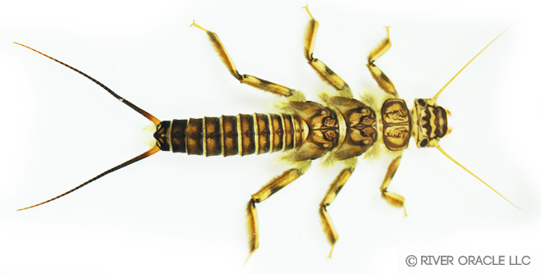
Stonefly nymph
Not on Abdomen
May see Gills on Thorax
Intro
Sensitive ID
Somewhat Tolerant ID
Tolerant ID
Methods
Data
Notes:
Here is a picture of a stonefly nymph.
Notice the gills on the thorax under the legs. When placed in a sorting tray of water, you may see the stonefly doing push ups to move water across the gills.

Slide 18
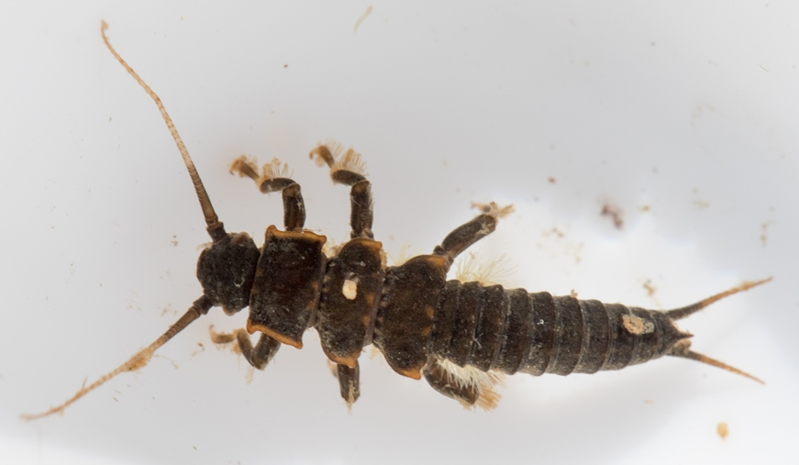
Stonefly nymph
Intro
Sensitive ID
Somewhat Tolerant ID
Tolerant ID
Methods
Data
Notes:
Here is another species of stonefly. The gills are not as easy to see, but we can see that it has two tails.

Slide 19
Stonefly nymph
Intro
Sensitive ID
Somewhat Tolerant ID
Tolerant ID
Methods
Data
Notes:
This is another photo of the giant stonefly, which is the largest stonefly in Missouri.
Stoneflies tend to be larger and more robust than many other invertebrates

Slide 20
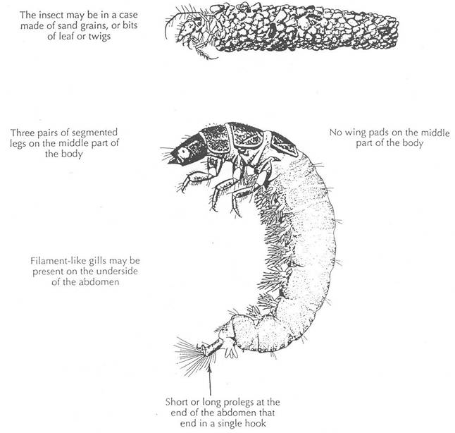
Anatomy of a caddisfly
Head
Case
Crunchy!
Thorax
6 Legs
Abdomen
“Mmmm,
Cream
Filled!”
Prolegs
Intro
Sensitive ID
Somewhat Tolerant ID
Tolerant ID
Methods
Data
Notes:
This invertebrate is quite a bit different than the mayflies and stoneflies.
The caddisfly larvae still has a head, thorax, abdomen, and three pairs of legs.
There are gills along the abdomen.
Caddisflies do not have tails, instead they have hooks called prolegs.
Along the thorax are one to three hard, chitinous plates.
Some species of caddisflies are free living, some are web spinning – yes like spiders -- and some are case makers.

Slide 21
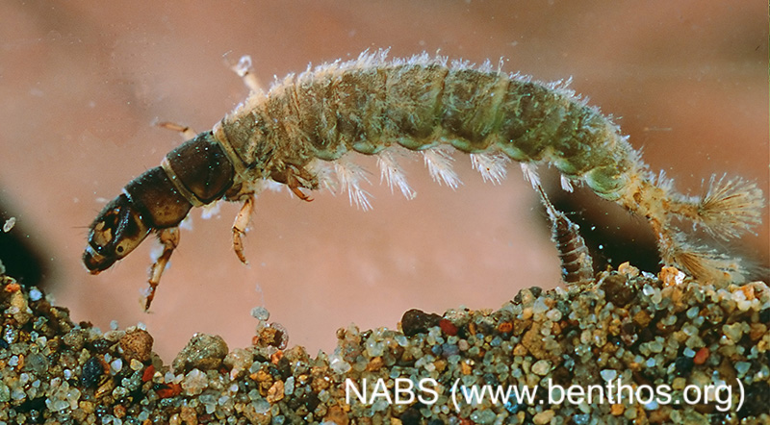
Caddisfly Larva
Prolegs
Intro
Sensitive ID
Somewhat Tolerant ID
Tolerant ID
Methods
Data
Notes:
Here is a picture of a free living caddisfly.
Notice the hard plates on the thorax, six legs, and the soft abdomen.
Gills are also observable along the abdomen. There are also two prolegs, which should not be confused with tails.

Slide 22
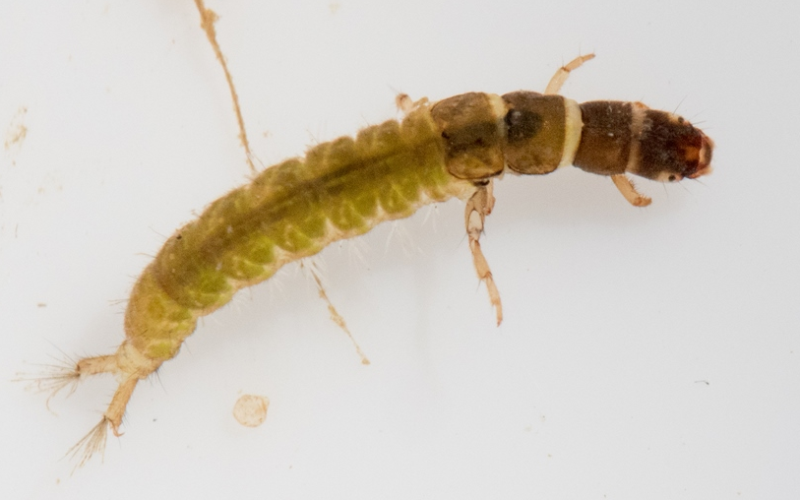
Caddisfly Larva
Intro
Sensitive ID
Somewhat Tolerant ID
Tolerant ID
Methods
Data
Notes:
Here is another image of a common caddisfly. Sometimes they can be yellow in color or green.

Slide 23
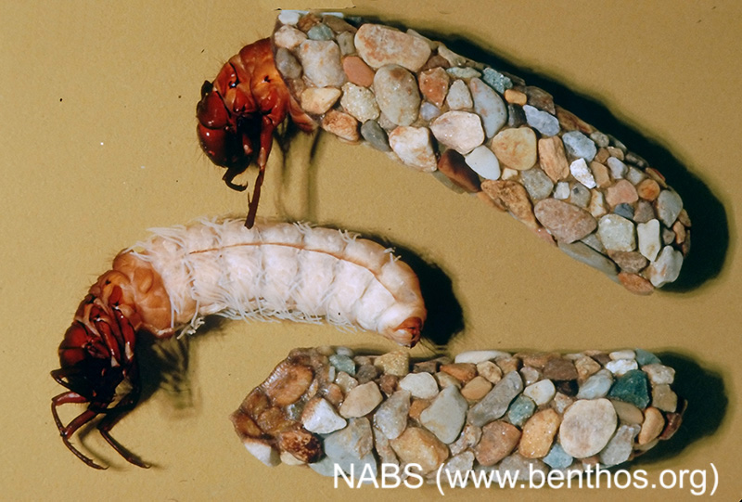
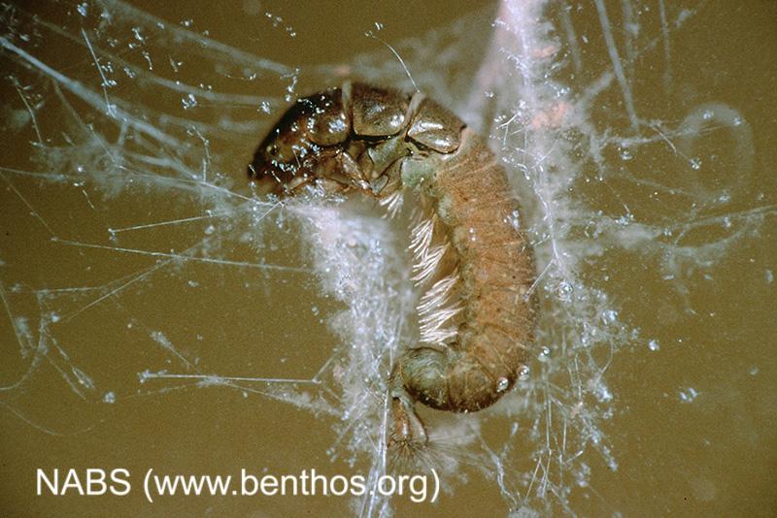
Caddisfly larva
Intro
Sensitive ID
Somewhat Tolerant ID
Tolerant ID
Methods
Data
Notes:
The image on the left shows a net spinning caddisfly. The spinneret of a caddisfly is located under its head.
The photo on the right shows cased caddisfly larvae. Cased caddisflies build their cases using silk and material of preference. Species can actually be identified by their case materials and shape, but that is not necessary for water quality monitoring.

Slide 24
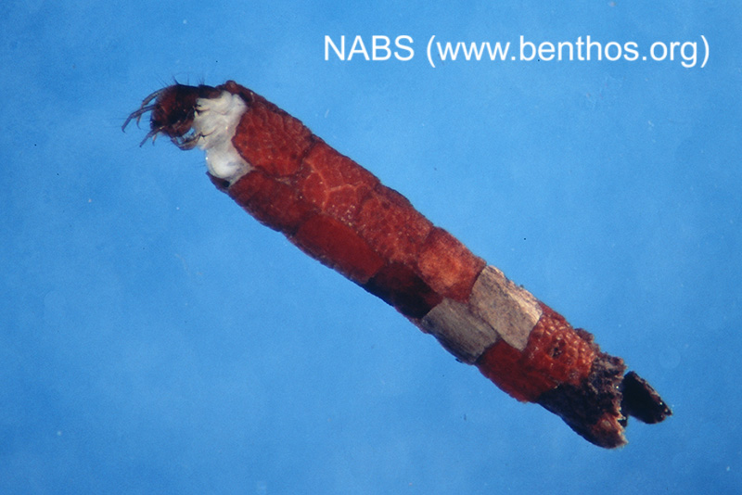
Caddisfly larva
Larva
Leaf Case
Intro
Sensitive ID
Somewhat Tolerant ID
Tolerant ID
Methods
Data
Notes:
This is another picture of a caddisfly in a case made from detritus or leaf material.
Anytime you find gravel stuck together or a tube of rocks or leaves, it is a strong indication of the presence of caddisflies.

Slide 25
Caddisfly larva
Caddisfly jewelry created by French artist Hubert Duprat
Intro
Sensitive ID
Somewhat Tolerant ID
Tolerant ID
Methods
Data
Notes:
This image is not a caddisfly case you will find in Missouri streams. Jewelry makers have used the assistance of caddisflies to make unique necklaces and earrings.
After a caddisfly pupates, it will leave behind the case for the jeweler to create accessories.

Slide 26
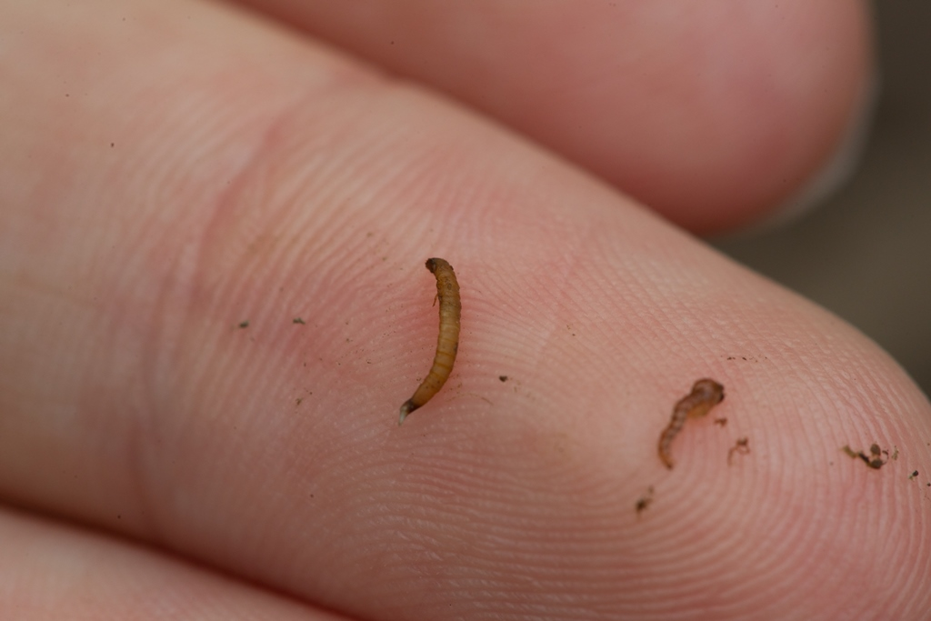
Riffle beetle
Intro
Sensitive ID
Somewhat Tolerant ID
Tolerant ID
Methods
Data
Notes:
Most of what you collect for biological monitoring will be juveniles, larvae and nymphs. The riffle beetle is an exception. You will collect both the juveniles and the adults of this aquatic beetle.
The image on the left is the juvenile. As you can see, it is very small. The adult is equally tiny.

Slide 27
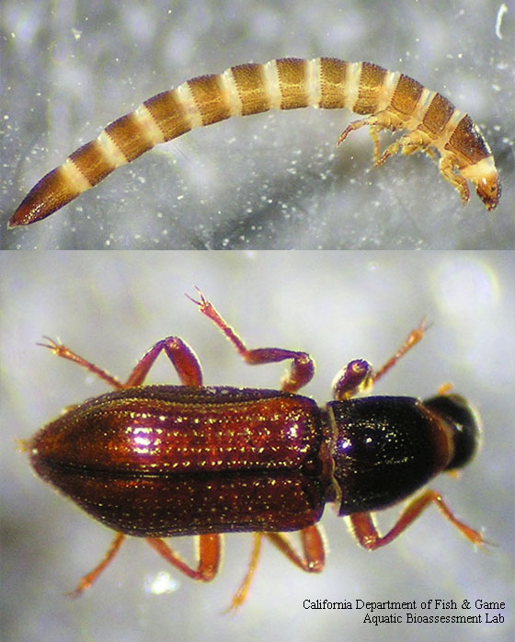
Riffle beetle larvae
Intro
Sensitive ID
Somewhat Tolerant ID
Tolerant ID
Methods
Data
Notes:
Riffle beetle larvae have a head, thorax, abdomen, and three pairs of legs. The thorax and abdomen are hard. The larvae have gills, but they are usually covered by a plate at the tip of the abdomen.
The adult riffle beetle is small and dark in color.
Both adult and larvae will be counted together for the data sheet, which will be covered later in the chapter.

Slide 28
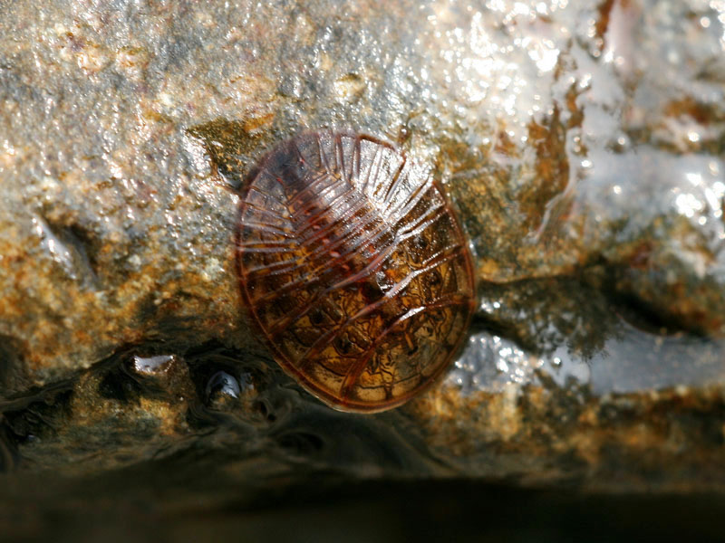
Water penny
HK River Net Photo
Intro
Sensitive ID
Somewhat Tolerant ID
Tolerant ID
Methods
Data
Notes:
Another beetle collected may be the water penny. This is a juvenile or larval beetle.
Water pennies have been described as looking like a fish scale stuck on a rock.
These can commonly be found clinging to the bottom of rocks in the stream.

Slide 29
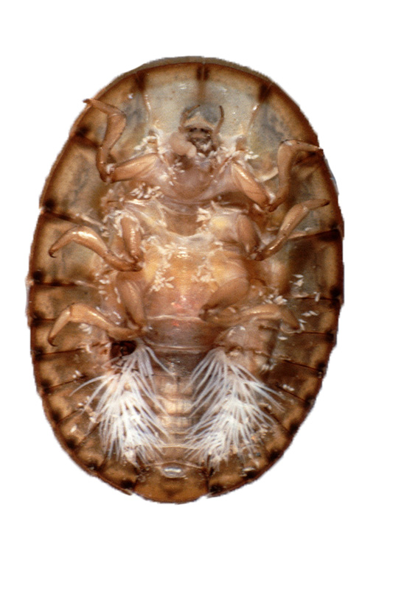
Water Penny
Head
Legs
Gills
Intro
Sensitive ID
Somewhat Tolerant ID
Tolerant ID
Methods
Data
Notes:
The image on the left show the top or dorsal side of the water penny larvae.
Looking at the underside of the water penny larvae, you can see the head, three pairs of legs, and gills.

Slide 30
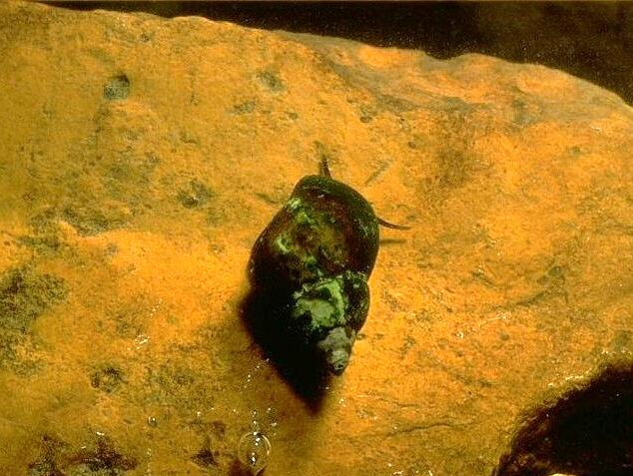
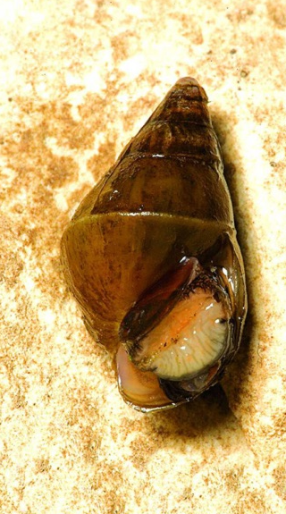
Gilled snail
Intro
Sensitive ID
Somewhat Tolerant ID
Tolerant ID
Methods
Data
Notes:
The only pollution sensitive taxa collected that does not have legs is the gilled snail.
We also refer to the gilled snail as a right-handed snail because the shell opens to the right when held with the apex or point facing up.
The gilled snail has an operculum which looks like a trap door over the opening.
Empty shells are not counted in biological monitoring. We will only count live organisms.

Slide 31
Gilled Snail
Intro
Sensitive ID
Somewhat Tolerant ID
Tolerant ID
Methods
Data
Notes:
This image shows the average size of gilled snails.
Note that the shell opens to the right when the apex is pointing up.

Slide 32
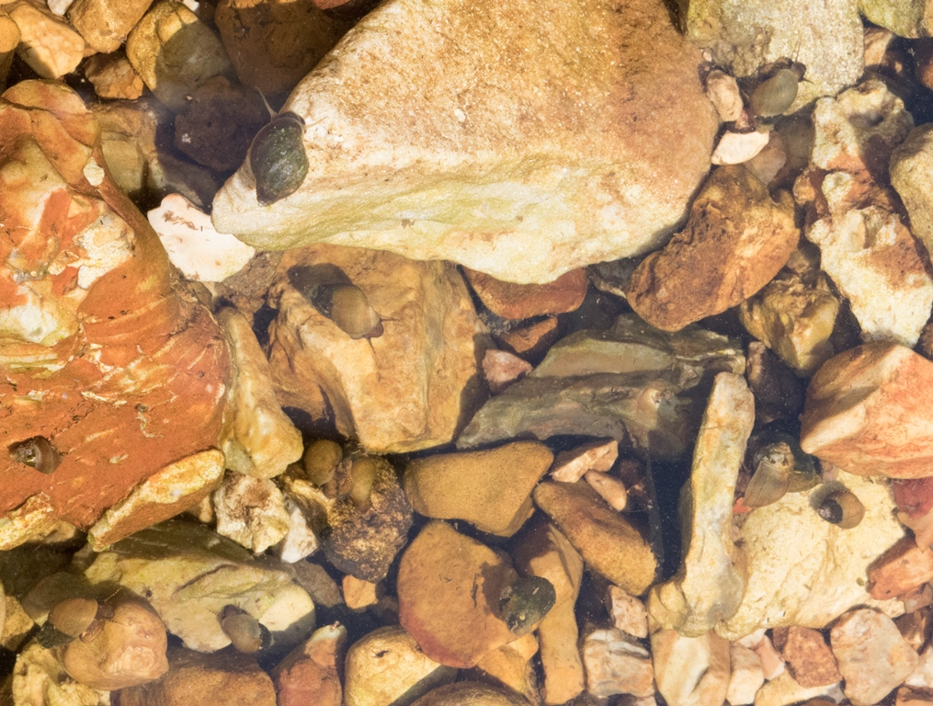
Gilled snail
Intro
Sensitive ID
Somewhat Tolerant ID
Tolerant ID
Methods
Data
Notes:
Aquatic snails can often be observed by just looking into a stream along the gravel or plants.

Slide 33
Let’s key out the next macroinvertebrate
Shell?
Legs?
How many legs?
Wings?
Tails?
Intro
Sensitive ID
Somewhat Tolerant ID
Tolerant ID
Methods
Data
Notes:
As you are learning to identify invertebrates, you may try using different identification resources, like a dichotomous key. A dichotomous key gives two choices for features until you finally land on an ID. Let’s practice using a dichotomous key for this invertebrate.

Slide 34
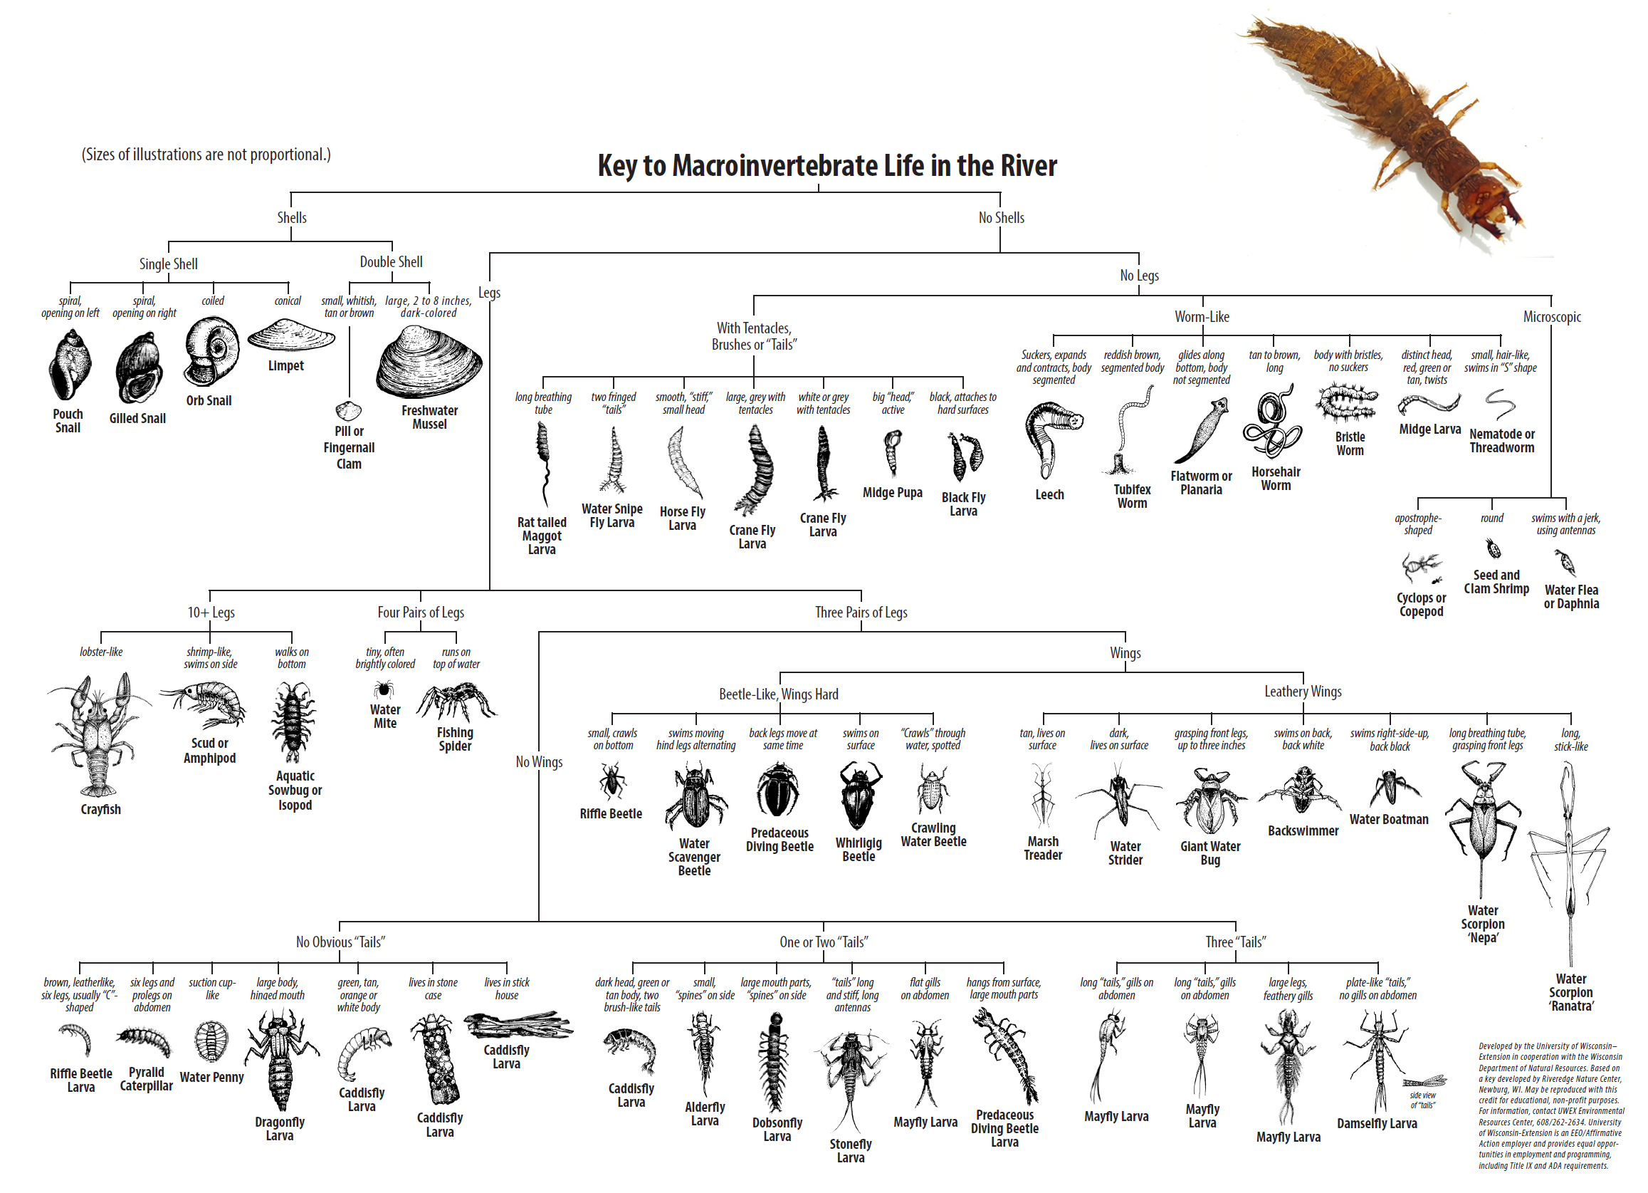
Notes:
This dichotomous key can be found on the website and can also be requested as a free print through Stream Team staff.
Starting at the top of the key, you will decide between the two choices which one best describes the invertebrates.
This invertebrates does not have a shell.
It has three pairs of legs.
No Wings.
It has one or two “tails”.
From these final choices of features, we can see that it has large mouth parts and “spines” on side.
This invertebrate is a dobsonfly larvae, also called a hellgrammite.

Slide 35
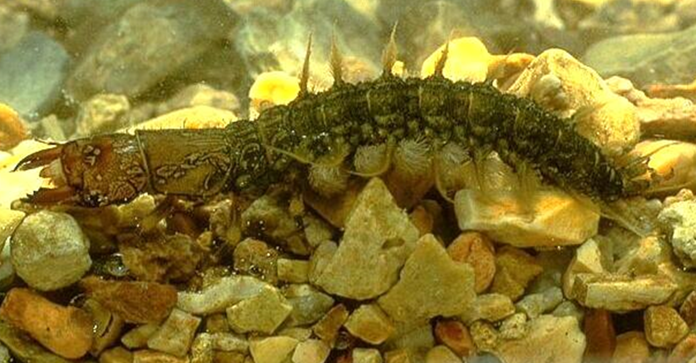
Hellgrammite (Dobsonfly larva)
Lateral filaments
Large mandibles
Gill tufts
Intro
Sensitive ID
Somewhat Tolerant ID
Tolerant ID
Methods
Data
Notes:
Hellgrammites, the larval stage of the dobsonfly, are one of the largest invertebrates which can be 4 inches in length.
These can have a two to three year larval period. So if you find a large hellgrammite it can be an indication that no major pollution events have occurred in your stream for a long time.
Key identifying characteristics of hellgrammites include large mandibles, filaments along the sides of the abdomen, and gill tufts under the filaments.
The color on the head may also appear mottled compared to other similar taxa.
When placed in a sorting tray of water, the gill tufts can be seen. When stressed, the hellgrammite may roll into a ball and the gills will be concealed.

Slide 36
INVERTEBRATE ID SOMEWHAT POLLUTION TOLERANT
Notes:
Next, we will discuss macroinvertebrates that are somewhat tolerant to pollution.

Slide 37
Somewhat tolerant taxa
Intro
Sensitive ID
Somewhat Tolerant ID
Tolerant ID
Methods
Data
Notes:
If you are referencing the Blue Bug Card, we will be working through group two taxa.

Slide 38
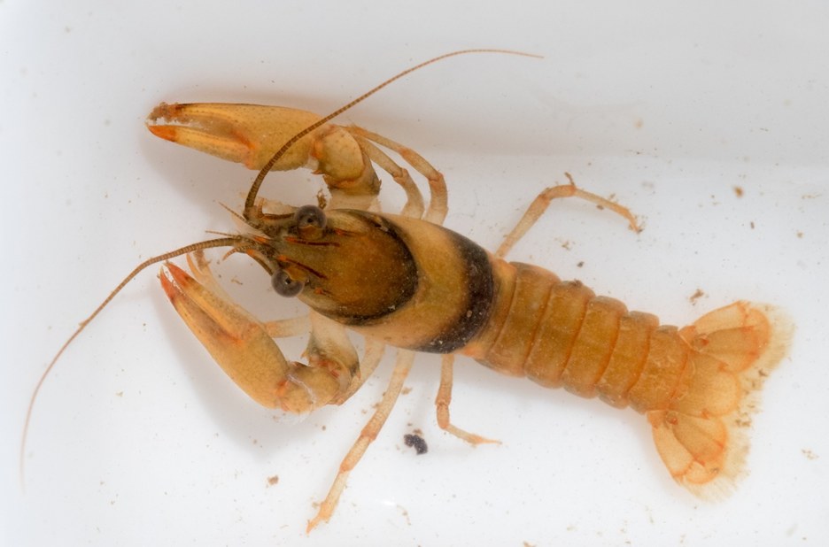
Crayfish
Intro
Sensitive ID
Somewhat Tolerant ID
Tolerant ID
Methods
Data
Notes:
The crayfish is one of the most easily recognized macroinvertebrates.
There are over 30 species of crayfish in Missouri, seven of which are found nowhere else in the world, and another 12 that share only limited range with neighboring states.
If you find a crayfish in your net, remove them immediately, record the number on your data sheet then return them to the water. Otherwise they may escape or make a meal of the other captured invertebrates, resulting in an inaccurate biological count.

Slide 39
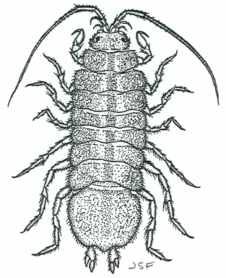
Sowbug
Intro
Sensitive ID
Somewhat Tolerant ID
Tolerant ID
Methods
Data
Notes:
This is a sowbug, or isopod. It is a crustacean, similar to the crayfish.
It is easy to identify because it resembles its terrestrial cousin, the roly-poly or pill bug.
The sowbug has several pairs of legs and appears flattened horizontally.

Slide 40
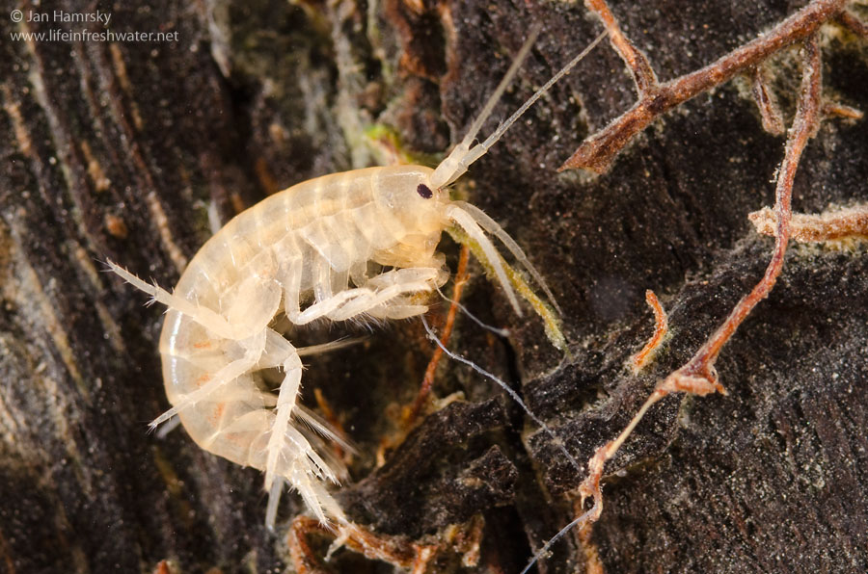
Scud
Intro
Sensitive ID
Somewhat Tolerant ID
Tolerant ID
Methods
Data
Notes:
The scud also has several pairs of legs, but appears to be flattened vertically.
This can be confused with freshwater shrimp, but is smaller in size.
When placed in a sorting tray of water, the scud swims quickly and often on its side. For this, it is also referred to as a side-swimmer.

Slide 41
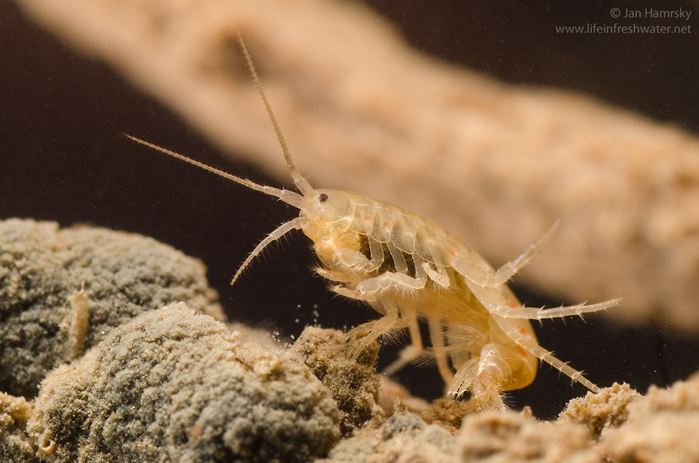
Scud
Intro
Sensitive ID
Somewhat Tolerant ID
Tolerant ID
Methods
Data
Notes:
Here is another photo of a scud, showing the several pairs of legs.

Slide 42
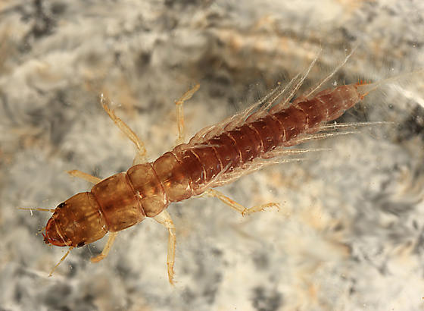
Alderfly Larvae
Single tail w/ “A” shaped base
Mandibles
No gills
© Tom Murray
Intro
Sensitive ID
Somewhat Tolerant ID
Tolerant ID
Methods
Data
Notes:
The alderfly larva is similar in appearance to the hellgrammite. They have the same pinching mouthparts.
The most obvious differences are that the alderfly does not have gills under its filaments. The filaments on an alderfly have a more delicate appearance than those of a hellgrammite.
The alderfly is also much smaller than the hellgrammite.
The abdomen ends in a point that looks like a tail in the shape of the capital letter A. We can say it’s A for Alderfly.

Slide 43
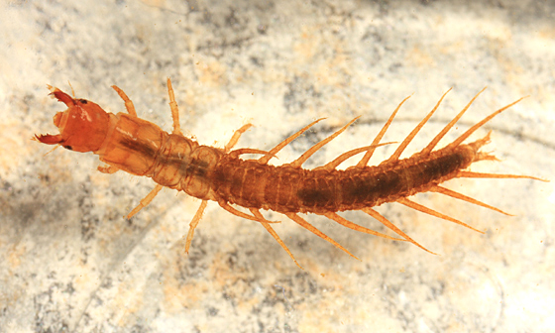
Fishfly larvae
Prolegs
No gills under
lateral filaments
© Tom Murray
Intro
Sensitive ID
Somewhat Tolerant ID
Tolerant ID
Methods
Data
Notes:
This image is a fishfly larva. It looks almost identical to the hellgrammite except it does not have gills under the lateral filaments.
The fishfly is also smaller in relative size than the hellgrammite. But remember, some hellgrammites can be smaller and easily confused with a fishfly.
The key identifying characteristic is the lack of gills under the lateral filaments.

Slide 44
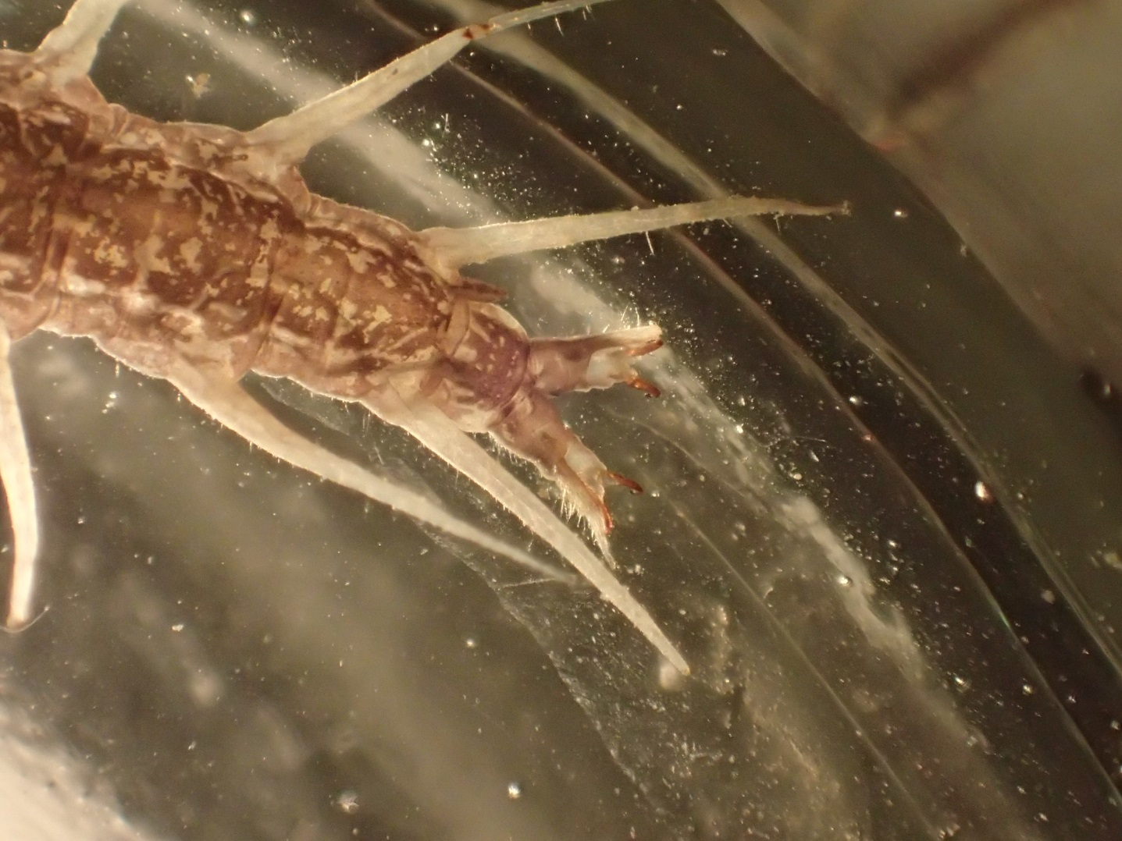
Fishfly Larvae
Breathing
tubes
Intro
Sensitive ID
Somewhat Tolerant ID
Tolerant ID
Methods
Data
Notes:
While not used as an identifying feature, breathing tubes may be seen on fishflies under a magnification.

Slide 45
Damselfly Nymph
Oar Shaped
Tails (Gills)
Intro
Sensitive ID
Somewhat Tolerant ID
Tolerant ID
Methods
Data
Notes:
The damselfly nymph has three broad oar shaped gills at the end of its abdomen. These should not be confused with the three hair-like tails of mayflies.
Like tails, the gills can be easily broken off while collecting invertebrates.
When placed in a sorting tray with water, the damselfly often stands with the gills pointed upwards.
Damselflies and dragonflies are usually found along the slower moving water along the stream banks and vegetation.

Slide 46
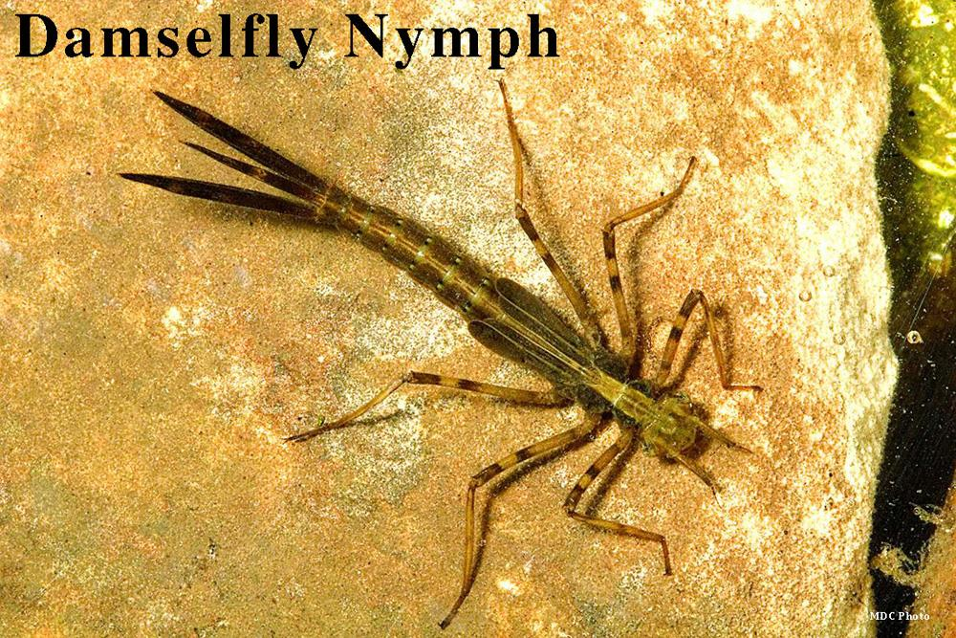
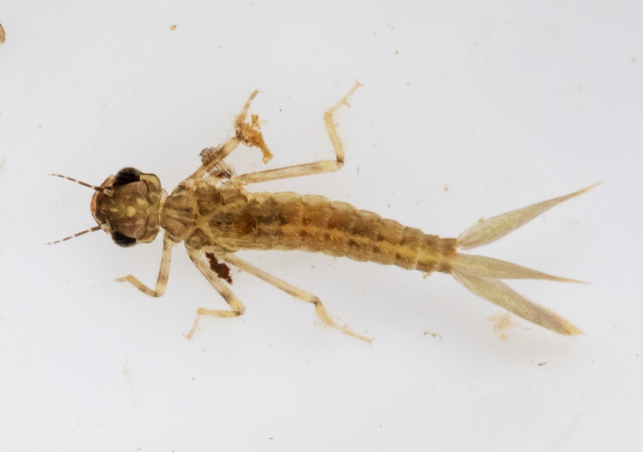
Damselfly Nymph
Intro
Sensitive ID
Somewhat Tolerant ID
Tolerant ID
Methods
Data
Notes:
Here are two other species of damselfies. While the body length differs, the oar like shape of the gills are similar.

Slide 47
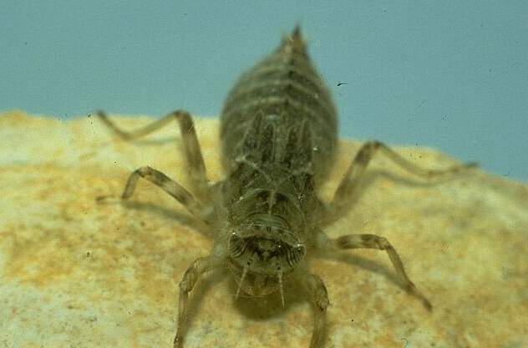
Dragonfly nymph
Segmented
legs
Wide
abdomen
Large eyes
Lower lip
Intro
Sensitive ID
Somewhat Tolerant ID
Tolerant ID
Methods
Data
Notes:
Dragonfly nymphs are closely related to the damselfly.
They are relatively large in size and lack a tail and gills.
The abdomen is relatively wide and has a leaf-like appearance.
Like the damselfly, the dragonfly also has a long, folded lower labium used for capturing prey.

Slide 48
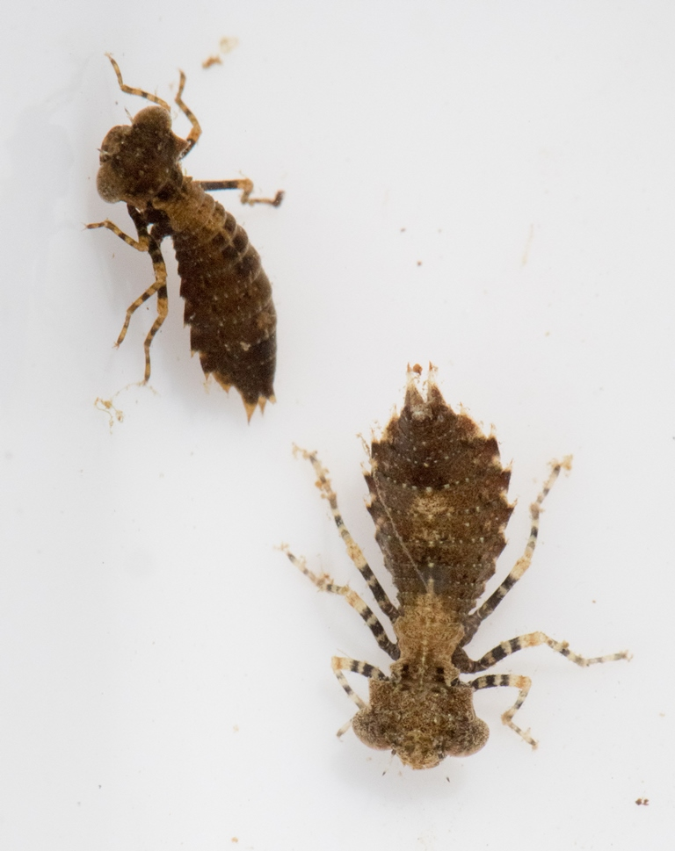
Dragonfly nymph
Intro
Sensitive ID
Somewhat Tolerant ID
Tolerant ID
Methods
Data
Notes:
Dragonfly nymphs can very in size and shape. These are a couple smaller species of dragonfly.

Slide 49
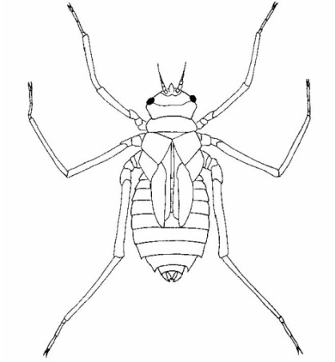
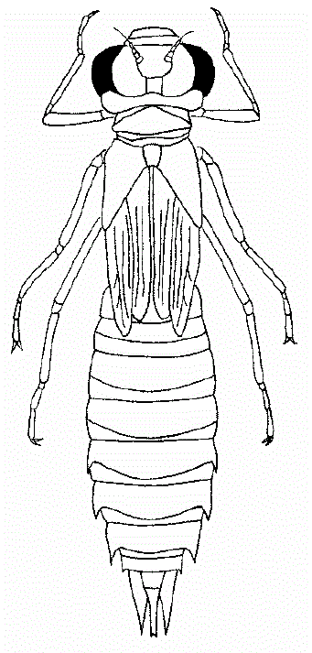
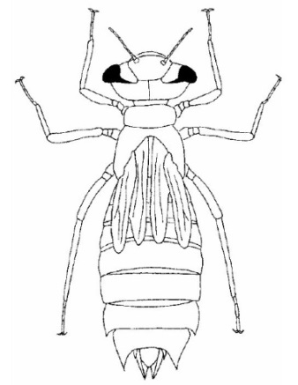
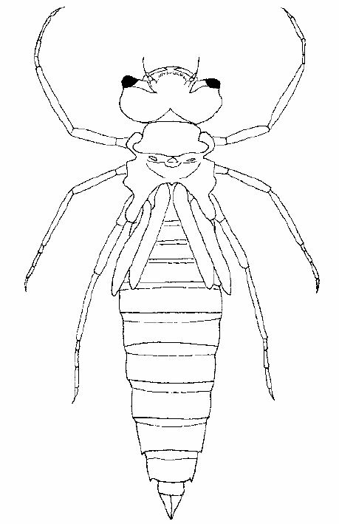
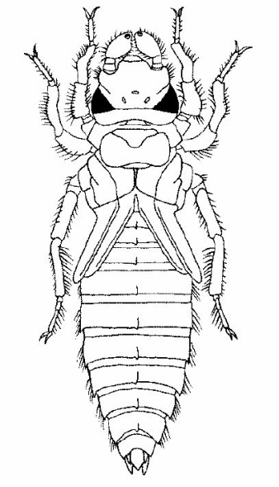
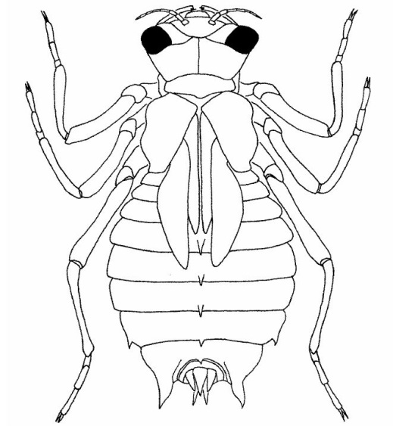
Dragonfly Nymphs
Intro
Sensitive ID
Somewhat Tolerant ID
Tolerant ID
Methods
Data
Notes:
Here are drawings that show other shapes of dragonfly nymphs. The key identifying characteristics is the lack of tail and gills and the leaf-like shape of the abdomen.

Slide 50
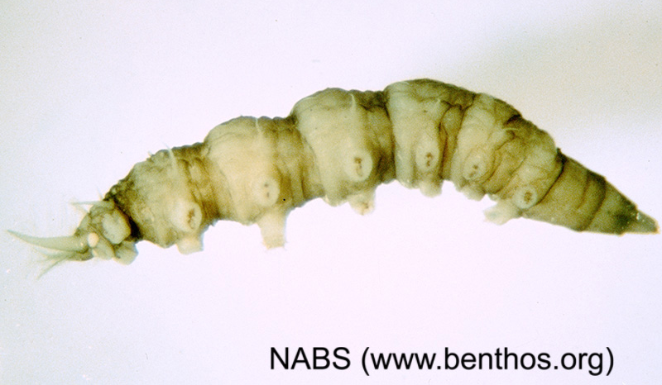
Watersnipe fly
Feathery
horns
Body segments
Intro
Sensitive ID
Somewhat Tolerant ID
Tolerant ID
Methods
Data
Notes:
Watersnipe flies are true flies with aquatic larvae.
They have body segments with prolegs on each.
Another identifying characteristic is two feathery horns.

Slide 51
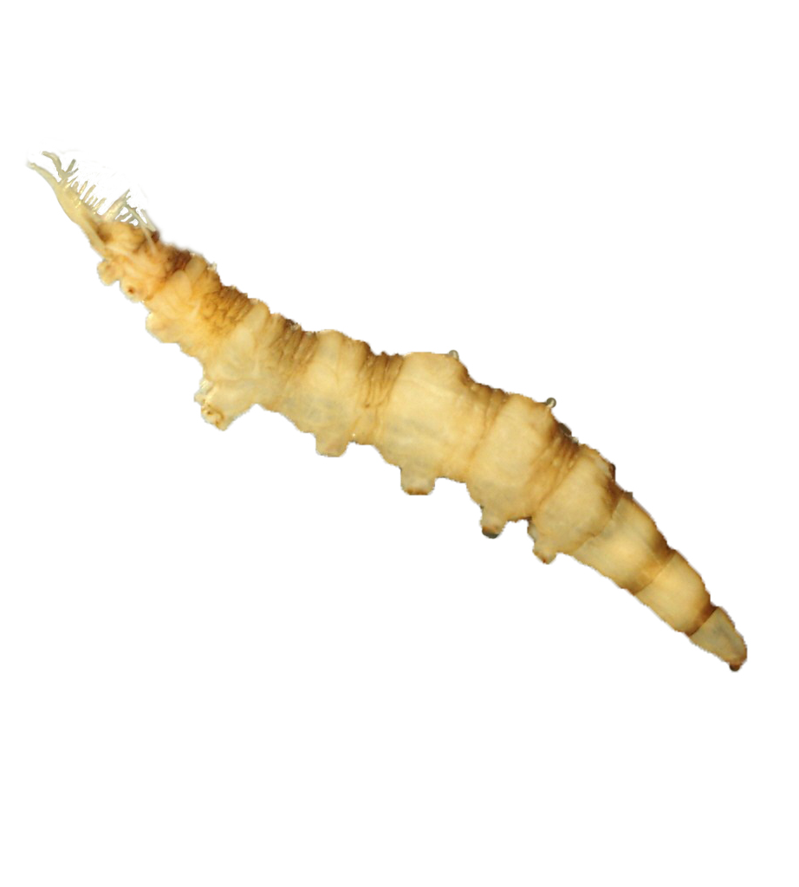
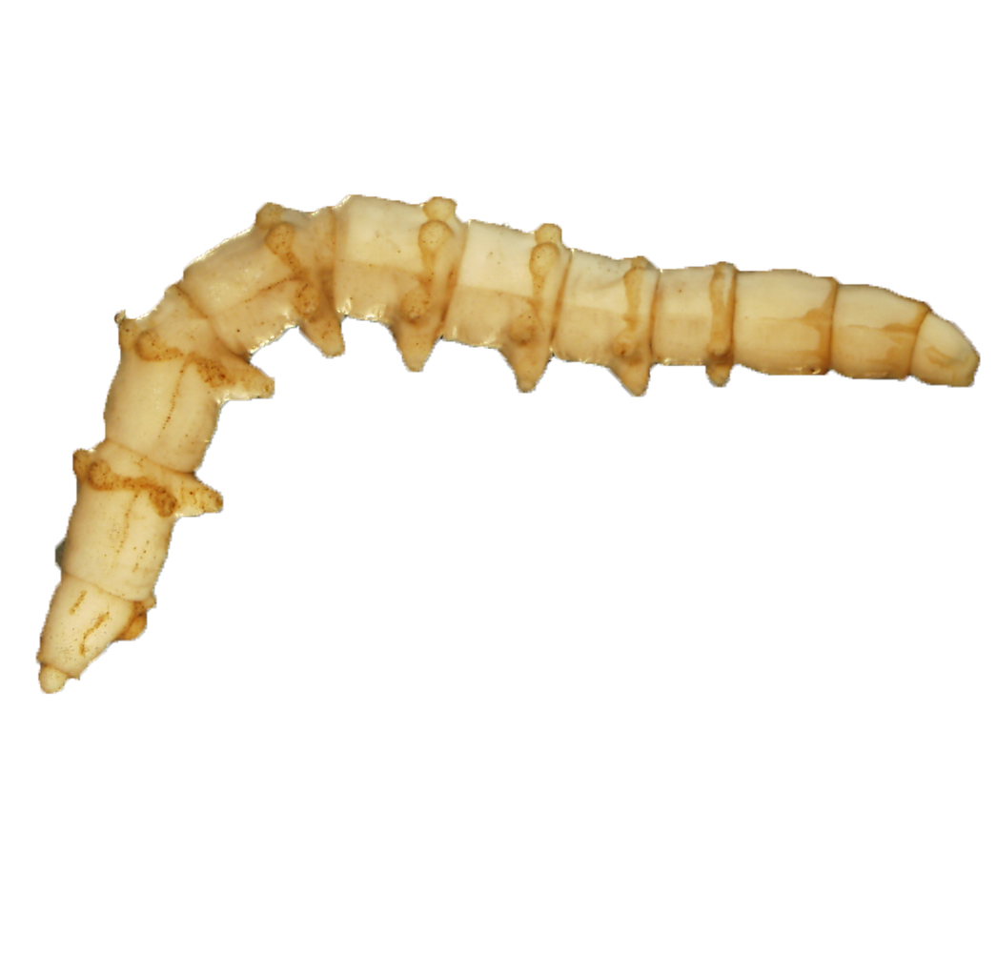
Watersnipe Fly vs. Horse Fly
Pointed both ends
Feathery horns
Caterpillar-like prolegs
Creeping welts
Watersnipe Fly
Horse Fly
Intro
Sensitive ID
Somewhat Tolerant ID
Tolerant ID
Methods
Data
Notes:
Watersnipe flies are very close in appearance to the common horse fly or deer fly.
They are about the same size and cream color.
Remember, the watersnipe fly has caterpillar-like prolegs on each body segment and two feathery horns.
The horse fly is pointed at both ends and has creeping welts around each body segment.
Horse flies are not counted in biological monitoring, but they can be recorded in the comments section of the data sheet.

Slide 52
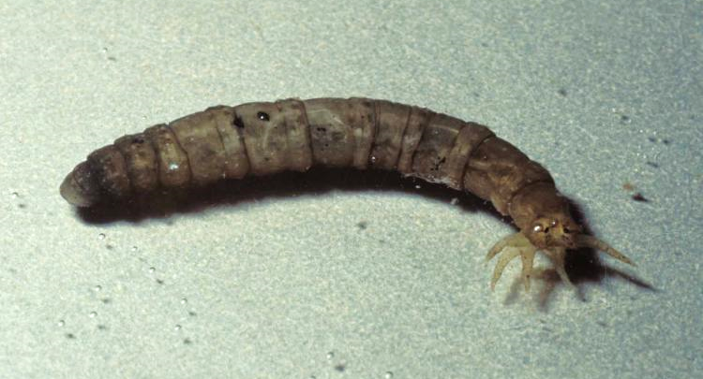
Crane fly larvae
Super squishy!
Finger-like
projections
Intro
Sensitive ID
Somewhat Tolerant ID
Tolerant ID
Methods
Data
Notes:
Crane fly larvae are another aquatic true fly larvae.
Most species are large, about the size of an index finger, and squishy.
They have finger-like projections or tulip-like bulb at the posterior end which help them anchor into substrate.
When placed in a sorting tray with water, crane fly larvae can be very active and escape the tray.

Slide 53
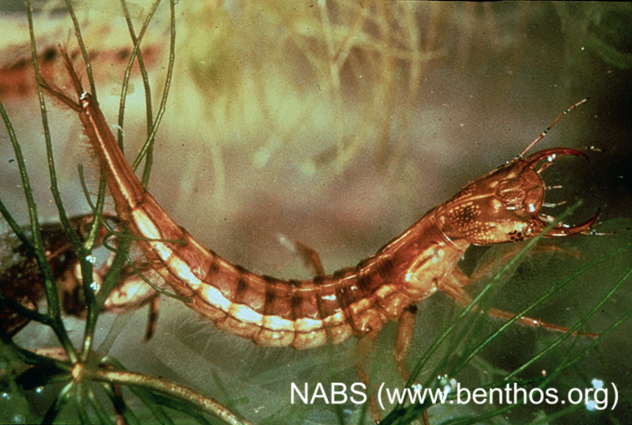
other beetle larvae
Many different types!
Process of elimination
Intro
Sensitive ID
Somewhat Tolerant ID
Tolerant ID
Methods
Data
Notes:
Occasionally, monitors may find larvae of other aquatic beetles other than riffle beetles or water pennies.
“Other beetle larvae” can be identified by process of elimination. If the characteristics don’t quite match those of other taxa, it’s probably an “other beetle larvae”.
If you are uncertain if an ID, you can take a photo and email it to Stream Team staff to help with identification.

Slide 54
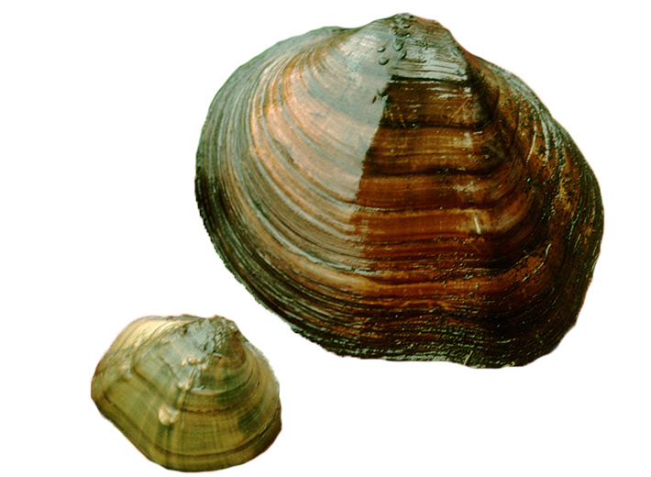
Freshwater mussels
Return to substrate with umbo up!
NABS Photo
Intro
Sensitive ID
Somewhat Tolerant ID
Tolerant ID
Methods
Data
Notes:
Freshwater mussels are somewhat tolerant to pollution.
This image shows two native mussels, the maple leaf. Native mussels tend to be asymmetrical and large compared to the invasive Asiatic clam.
It is estimated that over 70% of native mussels are either threatened or endangered. Therefore, volunteers are encouraged to return all clams and mussels to the stream system as quickly as possible in case they have collected one of the many threatened species. Mussels must be placed upright in the substrate with umbo or hinge up.
Like snails, do not count empty shells on the data sheet. We only count live organisms.

Slide 55
INVERTEBRATE ID POLLUTION TOLERANT
Notes:
Finally, we will discuss macroinvertebrates that are tolerant to pollution.

Slide 56
Tolerant taxa
Intro
Sensitive ID
Somewhat Tolerant ID
Tolerant ID
Methods
Data
Notes:
If you are following along with the Blue Bug Card, we will now go over the group three taxa.
As a reminder, pollution tolerant taxa can be found in all waters, polluted or healthy. The presence of a pollution tolerant species does not indicate impaired water. Lack of diversity and/or pollution sensitive taxa indicates impaired water.

Slide 57
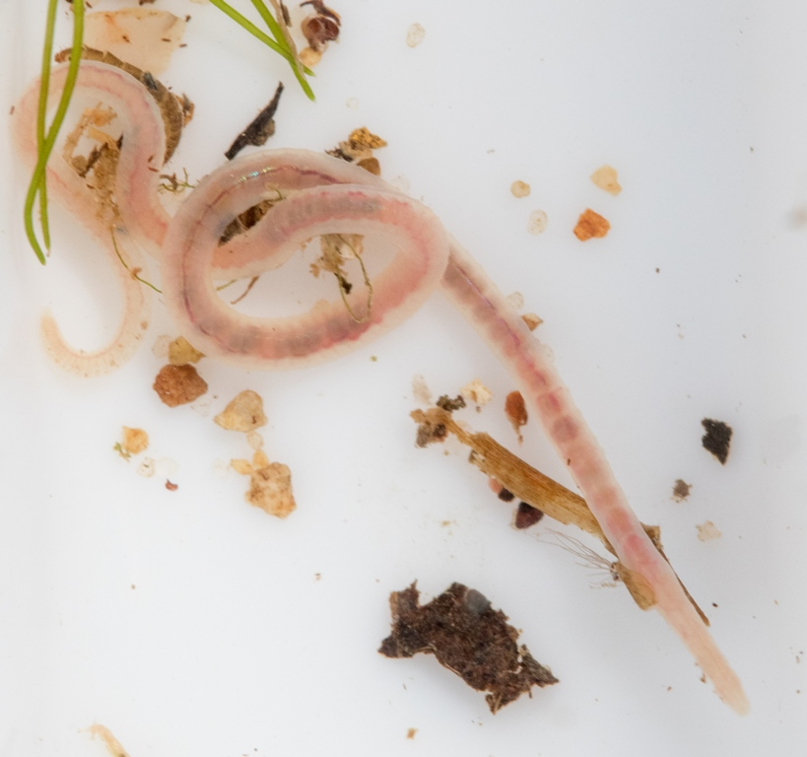
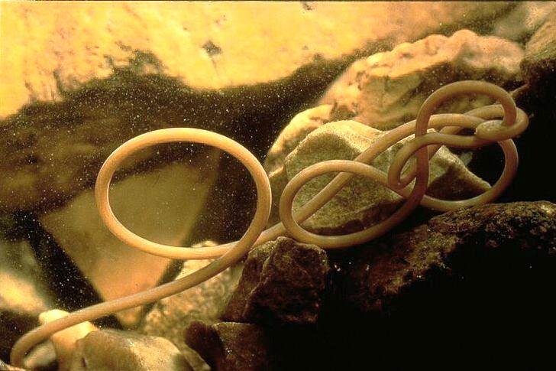
Aquatic Worm
Aquatic Earthworm
Horsehair Worm
Intro
Sensitive ID
Somewhat Tolerant ID
Tolerant ID
Methods
Data
Notes:
Aquatic earthworms are easily identified because they look like their terrestrial counterparts. They are segmented, long, thin, and often curl back around on themselves.
Note on both the Blue Bug Card and on your data sheets, all worm-like organisms, such as aquatic earthworms and horsehair worms, are lumped into one category called “aquatic worms.”

Slide 58
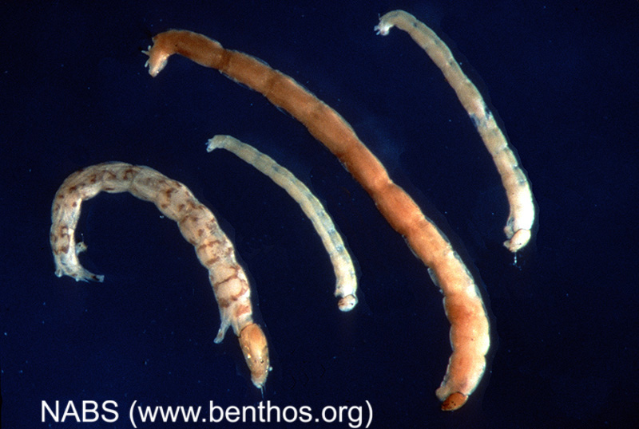
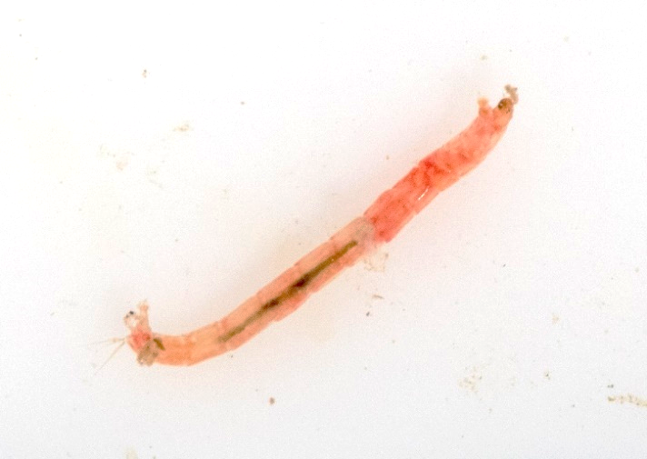
Midge fly larvae
Prolegs
Head
Intro
Sensitive ID
Somewhat Tolerant ID
Tolerant ID
Methods
Data
Notes:
Midge fly larvae are very tolerant to pollution.
They are tiny in size.
Midge larvae do not have legs, but do have a proleg under their head which can be seen on larger specimens.
When placed in a sorting tray with water, the midge fly larvae twitches about.

Slide 59
Midge Fly Larva
Blood Worm
Intro
Sensitive ID
Somewhat Tolerant ID
Tolerant ID
Methods
Data
Notes:
Midge larvae can be red in color.
This type of midge is commonly called a bloodworm, which is a misnomer because they are fly larvae, not worms.
This type of midge carries hemoglobin, which provides them a source of oxygen so they can live in water with very low oxygen levels, such as swamps.

Slide 60
Black fly larvae
Bowling Pin Shaped
Filter Feeding
Mouthparts
© Steve Marshall
Intro
Sensitive ID
Somewhat Tolerant ID
Tolerant ID
Methods
Data
Notes:
The black fly larvae has a wide posterior, a making it a bowling pin shape. They are very small in size.
The posterior has small hooks which allows it to adhere to a surfaces with a little silk.
When placed in a sorting tray with water, the black fly larvae often stick to the sides of the tray and sway in the water.

Slide 61
Black fly larvae
Intro
Sensitive ID
Somewhat Tolerant ID
Tolerant ID
Methods
Data
Notes:
Here is an image showing the filter feeding features of the black fly larvae.
Again, these are very small. Likely the only characteristic you will be able to see is the behavior of the larvae sticking to the side of the sorting tray.

Slide 62
Leech
Intro
Sensitive ID
Somewhat Tolerant ID
Tolerant ID
Methods
Data
Notes:
Common leeches in Missouri can look like a heavily muscled worm that is brown or black or mottled color.
The major identifying characteristic of the leech is the presence of a suction at one or both ends of the ventral or underside.

Slide 63
Leech vs planarian
Leech
Planarian
~ 1-12”
~ 0.5”
Eyespots
Sucker
Tapered head
Intro
Sensitive ID
Somewhat Tolerant ID
Tolerant ID
Methods
Data
Notes:
Monitors often confuse a planarian, or flat worm, with a leech.
The planarian has a tapered head and two eyespots which may be faint, but still present. They average about 0.5”, while a leech can grow to several inches.
Planarian are not counted on the data sheet but can still be included in the comments field at the bottom.
Planarian can fragment and regenerate, so you may have 4 planarian in your net but they may all be from one single organism. For this reason, they are not included in the count.

Slide 64
Pouch snail
Shell opens to the left
Intro
Sensitive ID
Somewhat Tolerant ID
Tolerant ID
Methods
Data
Notes:
A pouch snail lacks gills and an operculum, or trap door that covers the opening.
It is also referred to as a left-handed snail since the shell opens to the left when the apex is upwards.

Slide 65
other snail
Flat, not conical
Intro
Sensitive ID
Somewhat Tolerant ID
Tolerant ID
Methods
Data
Notes:
Not all snails you find will be left or right conical snails. Some snails are coiled or look like ramshorns. These go in the “Other snails” category of the data sheet.

Slide 66
Invertebrate specimen preservation
Notes:
Many monitors will collect invertebrates for biological monitoring, then return them to the stream immediately after. Some monitors may choose to keep invertebrates for a specimen collection or assistance with identification. We will go over how to properly preserve invertebrates that are kept in a specimen collection.

Slide 67
Ethyl alcohol (Denatured alcohol)
Dilute to 80% alcohol solution.
Best method for long-term storage.
More expensive than isopropyl and may be more difficult to find at retailers.
Located with painting supplies and may contain high percentage of methanol so check label or SDS for a product that is mostly ethyl alcohol.
Notes:
It is recommended to euthanize invertebrates in 100% alcohol solution. After at least 24 hours, the specimens may be transferred to a storage solution. Ethyl alcohol or ethanol is the preferred alcohol as it is less harsh on the specimens.

Slide 68
Isopropyl alcohol
Dilute to 40% alcohol solution; buffer with a drop or two of glycerin or a pinch of calcium carbonate antacid tablets.
Inexpensive and can be found easily at most general retailers.
Often harsh on invertebrates and can make them brittle over time.
Remember isopropyl alcohol comes in 70% or 90% concentrations.
Notes:
Isopropyl alcohol may also be used for preserving specimens. This is found in most households. Be aware of the concentration listed on the bottle to know how much water to add for diluting to 40% solution.

Slide 69
Hand sanitizer
Fill vial part way with sanitizer, insert specimen, then fill completely to top to avoid any air space between gel and cap; screw cap tightly.
Suspends invertebrates for easier viewing.
NOT recommended for soft-bodied or large invertebrates because hand sanitizers are only 60% alcohol.
Gel will break down into liquid over time; must be replenished occasionally.
Organism must be euthanized before being placed in the hand sanitizer.
Notes:
Hand sanitizer may be used for small specimens like black fly larvae and midge larvae. This medium allows for easier viewing of the specimens.

Slide 70
SAMPLING METHODS
Notes:
Before you can identify macroinvertebrates in your stream, you will need to collect them! We’ll go over the methods to collect invertebrates from the stream.

Slide 71
Sampling methods
Intro
Sensitive ID
Somewhat Tolerant ID
Tolerant ID
Methods
Data
Notes:
The first step in biological monitoring is collecting the invertebrates. Next, you will identify the invertebrates, then count them. The taxa present and quantities will help you analyze the stream’s health.

Slide 72
equipment
3’ x 3’ kick net
Sorting pan/tray*
Squirt bottle*
Forceps
Magnifying lens
D-net (select habitats only)
*Not provided by the VWQM Program
Intro
Sensitive ID
Somewhat Tolerant ID
Tolerant ID
Methods
Data
Notes:
The Missouri Stream Team program provides a kick net, forceps, and magnifying lenses for biological monitoring.
A monitor will need to supply their own sorting tray. It is recommended to use one or two white ice cube trays to easily sort and view invertebrates.
A squirt bottle is also helpful for warm or sunny days to keep the net wet while picking invertebrates.

Slide 73
Biological Monitoring
THREE NET SETS
TWICE PER YEAR
Three microhabitats
Late winter/early spring
Late summer/early autumn
Intro
Sensitive ID
Somewhat Tolerant ID
Tolerant ID
Methods
Data
Notes:
To sample for macroinvertebrates, you’ll need to find three different microhabitats in your stream for your three net sets. These microhabitats can be three different areas of riffle, like in the photo, or combinations of different habitats if there is not enough riffle habitat at your site for 3 samples.
Biological monitoring is conducted twice per year: once in the late winter/early spring before leaf-on and once in the late summer/early autumn before the leaves fall. This is because aquatic macroinvertebrates are largest at these times of year, and easiest to identify.

Slide 74
Habitat types
Riffles
Root Mats
Snags & Woody Debris
Non-Flow & Pools
Big River Region
Lowland Region
Ozark Region
Prairie Region
Intro
Sensitive ID
Somewhat Tolerant ID
Tolerant ID
Methods
Data
Notes:
Missouri has five aquatic faunal regions: big river region, lowland region, Ozark region, glaciated plains region, and Osage plains region. These last two are combined and referred to as the prairie region.
Each of these regions is characterized by different habitats and animals. For example, riffles are common in the Ozark region but are not common in prairie regions due to the gradient of the land.

Slide 75
Stream habitats
Ozark
Riffles
Root Mats
Prairie & Lowland
Root Mats
Snags & Woody Debris
Non-flow & Pools
Intro
Sensitive ID
Somewhat Tolerant ID
Tolerant ID
Methods
Data
Notes:
In the Ozark region, riffle and rootmats are a common aquatic habitat. Prairie and lowland regions characteristically have rootmats, snags, and pools.
These habitats are listed in order of preference for sampling.
Missouri Stream Team protocols are set up to sample riffles. But, if your site does not contain a riffle, you can alternatively sample rootmat. If there are no rootmats, you can sample snags, and finally, the last resort is sampling from a pool.

Slide 76
Stream habitats
Ozark
Riffles
Root Mats
Prairie & Lowland
Root Mats
Snags & Woody Debris
Non-flow & Pools
Intro
Sensitive ID
Somewhat Tolerant ID
Tolerant ID
Methods
Data
Notes:
We will discuss each habitat in detail and how to sample within each, starting with riffles.

Slide 77
Riffle
Riffle – Area that is shallow and swift due to a gradient drop
Aerates the water
Provides variety of habitats and food
Intro
Sensitive ID
Somewhat Tolerant ID
Tolerant ID
Methods
Data
Notes:
A riffle is a section of stream where water breaks over rocks. This action incorporates atmospheric oxygen into the water, resulting in higher dissolved oxygen levels. This means more oxygen for invertebrates.
Riffle habitat provides a variety of microhabitats for a diverse community of organisms.

Slide 78
microhabitats
Intro
Sensitive ID
Somewhat Tolerant ID
Tolerant ID
Methods
Data
Notes:
If this was our monitoring site, we could sample three microhabitats from these riffles, including the downstream riffle, the upstream riffle, and the riffle along the vegetation.
When sampling macroinvertebrates, start at the most downstream part of your site and work your way upstream. This prevents disturbing the other locations you will be sampling.

Slide 79
Sample collection
Place net in the riffle
Ensure bottom of net is on the stream bottom
Rub all large stones within 3’ area upstream of the net
Agitate the substrate 3-6” deep in 3’ area by dancing and kicking
Intro
Sensitive ID
Somewhat Tolerant ID
Tolerant ID
Methods
Data
Notes:
These are the steps to sample invertebrates from a riffle habitat. Essentially, you will be placing a net in the stream and dislodging invertebrates, so they float into the net.

Slide 80
Place net in riffle
Ensure bottom of net is on stream bottom
Weigh down bottom of net with large rocks
Intro
Sensitive ID
Somewhat Tolerant ID
Tolerant ID
Methods
Data
Notes:
First, place the program provided kick net in the riffle. Ensure the bottom of the net is taught and against the stream bottom. Medium to large sized rocks can be used to weigh down the front of net.

Slide 81
Remove and rub large rocks over net, then set aside.
Do the Benthic Boogie in 3’x3’ area, disturbing substrate 3-6” deep
Intro
Sensitive ID
Somewhat Tolerant ID
Tolerant ID
Methods
Data
Notes:
If there are any large rocks or boulders in the 3 foot area in front of the net, you can pick these up and rub them over the net before setting them aside. This will ensure you capture the invertebrates clinging to the rock while keeping your feet safe for the next step. In the 3 feet by 3 feet area in front of the net, twist your feet and agitate the substrate. The goal is to dislodge invertebrates into the water column so they float into the net.

Slide 82
Rub large rocks in net and set aside
Slowly lift net from stream, ensuring water does not pour over sides
Intro
Sensitive ID
Somewhat Tolerant ID
Tolerant ID
Methods
Data
Notes:
After you are done agitating the stream bottom, rub and remove the rocks from the front of the net. Slowly lift the net from the stream, taking care to not spill the water and invertebrates from the net.

Slide 83
Move to land to pick and sort invertebrates from net
Intro
Sensitive ID
Somewhat Tolerant ID
Tolerant ID
Methods
Data
Notes:
Carefully move the net to the stream bank. Now is the fun part of picking invertebrates from the net and placing them in a sorting tray.
Recording the data from this net set will be covered later in the chapter.

Slide 84
Stream habitats
Ozark
Riffles
Root Mats
Prairie & Lowland
Root Mats
Snags & Woody Debris
Non-flow & Pools
Intro
Sensitive ID
Somewhat Tolerant ID
Tolerant ID
Methods
Data
Notes:
If you don’t have any riffles within your monitoring site, the next habitat to look for is rootmat.

Slide 85
Root mats
Root Mat - Matted roots of vegetation hanging into the water or growing out of stream bank
Intro
Sensitive ID
Somewhat Tolerant ID
Tolerant ID
Methods
Data
Notes:
Rootmats are the fibrous roots that hang out of or over a streambank and into the water.

Slide 86
Damselflies, dragonflies, mayflies, caddisflies, and midges are common in root mats
Intro
Sensitive ID
Somewhat Tolerant ID
Tolerant ID
Methods
Data
Notes:
Sampling in different habitats will reveal different communities of invertebrates. Damselflies and dragonflies are commonly found in rootmats and vegetation.

Slide 87
Place net downstream of root mat
Kick and swirl water through roots into net
Intro
Sensitive ID
Somewhat Tolerant ID
Tolerant ID
Methods
Data
Notes:
To sample invertebrates from a rootmat, the same program provided kick net is used.
First, place the kick net downstream of the root mat, with the edge next to the bank. Kick and swirl the water under the root mat so invertebrates dislodge and float down into the net.
Use your foot to disturb the root mat, not your hands. There may be biting critters in there or poison ivy.

Slide 88
Slowly lift net from stream, ensuring water does not pour over sides
Move to land to pick and sort invertebrates from net
Intro
Sensitive ID
Somewhat Tolerant ID
Tolerant ID
Methods
Data
Notes:
Slowly lift the net from the stream, making sure that water and invertebrates do not spill over the sides.
Move the net to land to pick and sort the invertebrates into a sorting tray.

Slide 89
Stream habitats
Ozark
Riffles
Root Mats
Prairie & Lowland
Root Mats
Snags & Woody Debris
Non-flow & Pools
Intro
Sensitive ID
Somewhat Tolerant ID
Tolerant ID
Methods
Data
Notes:
If your site has no riffles or rootmats to sample, you can sample snags or woody debris.

Slide 90
snag
Snag – Woody debris such as tree limbs, logs, and sticks in the water
Decomposing worm-wood is best
Intro
Sensitive ID
Somewhat Tolerant ID
Tolerant ID
Methods
Data
Notes:
A snag is a tree, a limb, or other woody debris in the water. Once the debris begins to decompose, it becomes soft and invertebrates start to move in.

Slide 91
Place net horizontally underneath snag
2. Use a brush to scrub woody debris over the net
3. Move net to land to pick and sort invertebrates
4. Repeat steps to sample ~ 3-5 snags for 1 net set
Intro
Sensitive ID
Somewhat Tolerant ID
Tolerant ID
Methods
Data
Notes:
To sample a snag or woody debris, place the net horizontally under the woody debris.
Use a stiff bristled brush to scrub the surface of the snag. The goal is to dislodge the invertebrates so they fall or float into the net. Do not use your bare hands.
Move the net to land to pick and sort invertebrates into a sorting tray.
Three to four pieces of small woody debris like the one in this photo are needed for a single net set.

Slide 92
Stream habitats
Ozark
Riffles
Root Mats
Prairie & Lowland
Root Mats
Snags & Woody Debris
Non-flow & Pools
Intro
Sensitive ID
Somewhat Tolerant ID
Tolerant ID
Methods
Data
Notes:
If no other habitats exist in your monitoring site, you can sample in pools or non-flow areas.

Slide 93
Non-flow
Non-Flow or Pool – Areas of the stream with no observable flow
Intro
Sensitive ID
Somewhat Tolerant ID
Tolerant ID
Methods
Data
Notes:
When sampling in a pool, the flow of the water is improvised by shuffling backwards and trailing the D-net in front of you to catch invertebrates.

Slide 94
Hold D-frame net downstream of where you stand
Shuffle feet to disturb substrate 6-12” deep
Holding net just above substrate, sweep net back and forth through water
Intro
Sensitive ID
Somewhat Tolerant ID
Tolerant ID
Methods
Data
Notes:
A D-frame net is required if sampling non-flow areas.
First, hold the net downstream of where you are standing with the opening of the net facing you.
Shuffle your feet to agitate the substrate. While shuffling your feet, sweep the net back and forth to capture suspended invertebrates.

Slide 95
4. Repeat as you shuffle upstream, sampling a 3’x 3’ area of
stream bottom
Intro
Sensitive ID
Somewhat Tolerant ID
Tolerant ID
Methods
Data
Notes:
Continue shuffling and sweeping until you have sampled a 3 feet by 3 feet area.
Remove the net from the water and take to land to sort the invertebrates.

Slide 96
remember
Collect samples in an upstream direction
Don’t collect inverts from disturbed areas
Consistency-sample same habitats each time you monitor
Intro
Sensitive ID
Somewhat Tolerant ID
Tolerant ID
Methods
Data
Notes:
For any habitat sampled, always collect invertebrates in an upstream direction. Start at the riffle or habitat furthest downstream with your site, then work upstream.
Avoid walking through habitat that you plan to sample. Disturbing the habitat before you sample can dislodge the invertebrates before you’re ready to collect them.
Be consistent in the habitats you sample. Aim for sample replicates of the same habitat each time you monitor. Ideally, this would be three riffles each monitoring trip.

Slide 97
BIOLOGICAL DATA
Notes:
After invertebrates are collected and identified, how do you record the data? We will cover data recording and analysis next.

Slide 98
Sample analysis
Remove invertebrates from net and place into sorting tray
Record time spent removing invertebrates (Picking Time)
Identify invertebrates
Count invertebrates and record on datasheet
Intro
Sensitive ID
Somewhat Tolerant ID
Tolerant ID
Methods
Data
Notes:
After invertebrates are collected from the stream, you will remove them from the net, sort them into trays, identify them, and count them to record on the data sheet.
If fish are collected in the net, return them into the water immediately. If any crayfish or mussels are collected in the net, count them and immediately return them to the water.

Slide 99
Header information
Don’t forget habitat and
net type!
Time spent picking, NOT counting and identifying.
Record actual numbers counted. Do not estimate!
Do not use tally marks to record numbers.
Must have 3 net sets to calculate WQR
Intro
Sensitive ID
Somewhat Tolerant ID
Tolerant ID
Methods
Data
Notes:
Let’s take a look at the macroinvertebrate data sheet, also referred to as the biological monitoring data sheet.
As with every data sheet, make sure the header is filled out entirely.
Three net sets are required for this data to be accepted. This means you will make three trips into the water to collect invertebrates, sort them, ID them, and count them.
For each of these net sets, you will record habitat type and select the type of net you used, which is a kick net for most monitors.
The amount of time spent picking invertebrates off the net is recorded, but we do not record the amount of time identifying. We also record the number of people that helped pick the net.
For each invertebrate taxa present, record the number for the respective net set. This needs to be a number, not a check for presence/absence.
In the far right column, it shows Circle Types Present and a corresponding weight or score for each taxa. The sensitive taxa have a score of 3 while tolerant taxa are a 1. If there was a presence of a taxa in any of the three net sets, circle the corresponding score in the right column. These will be added up to give the Water Quality Rating. A score of less than 12 can indicate poor water quality conditions, 12 to 17 is fair, 18 to 23 is good, and greater than 23 indicates excellent water quality.

Slide 100
Instructions on back of data sheet!
Intro
Sensitive ID
Somewhat Tolerant ID
Tolerant ID
Methods
Data
Notes:
Instructions and tips can be found on the backside of the datasheet if you feel lost.

Slide 101
Sampling scenario 2008
Intro
Sensitive ID
Somewhat Tolerant ID
Tolerant ID
Methods
Data
Notes:
Let’s look at an example of why it’s important to compare data over time.
This data was collected on April 6, 2008 on Turkey Creek. There is a good diversity of organisms found and the sensitive taxa are plentiful. The Water Quality Rating is 25, which indicates excellent water quality.

Slide 102
Sampling scenario 2009
Intro
Sensitive ID
Somewhat Tolerant ID
Tolerant ID
Methods
Data
Notes:
Exactly one year later, another data sheet was completed on April 6, 2009 at the same site on Turkey Creek. Notice there has been a shift in populations. There are now more tolerant taxa than sensitive. But, the Water Quality Rating is still 25.
Something has happened in this stream system to shift the populations. One of the other data sheets, such as chemistry or visual survey, may provide some insight to what has changed to cause this shift.
This example also shows why it’s important to record quantity, not just presence/absence.

Slide 103
Factors that affect water quality rating
Substrate
Discharge
Water Temperature
Stream Size
Water Chemistry
Physical Factors
Taxonomic Level
Intro
Sensitive ID
Somewhat Tolerant ID
Tolerant ID
Methods
Data
Notes:
There are many factors that can affect the water quality rating, which may not necessarily reflect onto the stream health.
The type of habitat the stream provides will affect the rating. Silt and sand bottom streams will generally have lower ratings than streams with cobble substrate.
Sensitive organisms require water with some flow because it helps oxygenate the water. But too much velocity can dislodge and sweep away invertebrates.
Invertebrates thrive in cooler water, where oxygen is also higher. It may be difficult to find invertebrates in a warm stream in the hot summer sun or where there is not shade from a riparian corridor.
Different invertebrate communities can be found in different stream sizes, like small headwater streams or larger third order streams. Aquatic habitats and stream flow are very different between these two sizes, therefore support different communities.
A balance of chemical constituents must be maintained to support a diversity of aquatic life. Imbalances will result in changes in the stream that will alter what can live there. Certain chemicals are toxic to organisms, and if they are present in large enough quantities or for long enough time, it will kill organisms in a stream.
Habitat, flow, and rates of soil erosion are all physical factors that affect aquatic life. Poor ratings can often be attributed to physical conditions in the stream rather than a point source discharge or a single chemical pollutant.
Finally, the taxonomic level to which we identify can also have an affect on the water quality rating. We generalize pollution tolerance to an entire taxa. But in reality, some species under that taxa may be more or less tolerant to pollution.

Slide 104
Analysis scenario 1
Observation:
High density
High diversity
Many sensitive taxa (ex. stoneflies, caddisflies, mayflies)
Analysis:
No problem. Good water quality.
Intro
Sensitive ID
Somewhat Tolerant ID
Tolerant ID
Methods
Data
Notes:
After you collect macroinvertebrate data, you may want to know how to analyze your findings. Let’s go over a few scenarios which monitors may experience.
If your monitoring site has a high density or a lot of invertebrates, a high diversity or many different taxa of invertebrates, including many sensitive tax, this would indicate the stream is healthy and water quality is good.

Slide 105
Analysis scenario 2
Observation:
Low density
High diversity
Analysis:
Possible poor habitat conditions or recent flooding.
Intro
Sensitive ID
Somewhat Tolerant ID
Tolerant ID
Methods
Data
Notes:
In this scenario, we still have high diversity, but we have low density of invertebrates. So, lots of different kinds of invertebrates, but just not very many of anything. This could indicate poor habitat conditions or recent flooding.

Slide 106
Analysis scenario 3
Observation:
High density
Low diversity
Analysis:
Organic pollution or sedimentation; Excessive algal growth from eutrophication
Intro
Sensitive ID
Somewhat Tolerant ID
Tolerant ID
Methods
Data
Notes:
In this third scenario, we have high density but low diversity, So lots of invertebrates, but only a few different taxa. This could indicate too many nutrients in the stream, or eutrophication. You may observe sedimentation or an algal bloom.

Slide 107
Analysis scenario 4
Observation:
Low density or no invertebrates
Low diversity
Stream appears clean
Analysis:
Toxic pollution (e.g. chlorine, acid, heavy metals, pesticides); unproductive
Intro
Sensitive ID
Somewhat Tolerant ID
Tolerant ID
Methods
Data
Notes:
In the last scenario, we have very few invertebrates and not very many taxa. The water appears clear and clean.
This could indicate toxic pollution, such as chlorine. This can occur if there is a water main break or if a pool is draining into a stream.

Slide 108
OTHER ORGANISMS TO CONSIDER
Notes:
While we have identified lots of invertebrates you will be identifying in the field, there are some other organisms to consider, from endangered species to nuisance species.

Slide 109
Endangered species
Niangua darters
Small fish listed as state endangered and federally threatened
Spawns in riffles
Spawning period: March 15 through June 15
Sampling invertebrates can be detrimental to spawning
Intro
Sensitive ID
Somewhat Tolerant ID
Tolerant ID
Methods
Data
Notes:
There is an endangered species that spawns in riffles during times when monitors like to sample streams.
The Niangua darter is a small fish that is listed as Missouri state endangered and federally threatened.
Because the Niangua darter spawns in riffles, kicking up macroinvertebrates can be detrimental to spawning.
For monitoring sites in the Niangua darter range, we ask that monitors avoid sampling between March 15 through June 15.

Slide 110
Niangua darter range as of 2017
Localized in a few tributaries of the Osage River
Highest Remaining populations:
Niangua River
Little Niangua
Intro
Sensitive ID
Somewhat Tolerant ID
Tolerant ID
Methods
Data
Notes:
Here is a map of Niangua darter range. This includes the Niangua River watershed, The Sac River watershed, the Tavern Creek watershed, and the Maries River and Pomme de Terre River.
Again, please do not monitor these streams between March 15 and June 15.

Slide 111
Aquatic nuisance species
Zebra mussel
Chinese mystery snail
Rusty crayfish
Hydrilla
Intro
Sensitive ID
Somewhat Tolerant ID
Tolerant ID
Methods
Data
Notes:
It’s important to be mindful of nuisance species, as well. Some of the invasive species in Missouri streams are zebra mussel, Chinese mystery snail, rusty crayfish, and hydrilla.
Familiarize yourself with possible nuisance species in your streams. It’s important to always clean and dry your equipment, boots, and boats after being in the water to prevent spreading these species.
Most monitors are not sampling in multiple streams in the same day, so their equipment is dry by the time they sample again. BUT, if you are sampling in multiple streams in a single day, you will need to disinfect your equipment.

Slide 112
Nuisance species prevention
Technique | Duration | Concentration | Solution | Comments
Vinegar | 20 min. | 100% | 1 gallon of vinegar, no water | Safety glasses and gloves should be worn. Corrosive to metal and toxic to fish.
Chlorine (6% household bleach) | 10 min. | 3% | 4 oz of bleach and 1 gallon of water | Before re-use rinse with water but don't let the solution runoff directly to the stream.
Air Drying | 3-5 days | NA | NA | Equipment must dry completely.
Freezing < 32°F | 24 hours | NA | NA | Must be below freezing for duration of contact time.
Salt Bath | 24 hours | 1% | 1/8 cup in 1 gallon of water | Equipment must be completely submerged.
Notes:
Here are a few methods to disinfect monitoring equipment and waders.
The easiest method is air drying all equipment for three to five days.
If a monitor is going between bodies of water more frequently, vinegar or bleach may be used.
This table can be found in the Introduction to Volunteer Water Quality Monitoring notebook on the Stream Team website.

Slide 113
BIOLOGICAL MONITORING
Which is the best definition for “benthic”?
Where are the gills are located on the body of a mayfly nymph?
How tolerant of pollution are crayfish?
Are pouch snails only found in polluted
waters?
How many net sets do you need to collect each time you sample macroinvertebrates?
How long should you pick a net set?
Notes:
If you want to test your knowledge on Biological Monitoring, you can pause this video and review these questions.

Slide 114
Contact us
mostreamteam.org
Streamteam@dnr.mo.gov
Streamteam@mdc.mo.gov
youtube.com/@MissouriStreamTeam
facebook.com/mostreamteams/
800-781-1989
Notes:
Additional resources and training videos can be found online. Contact us if you have any questions.

